Slide 1
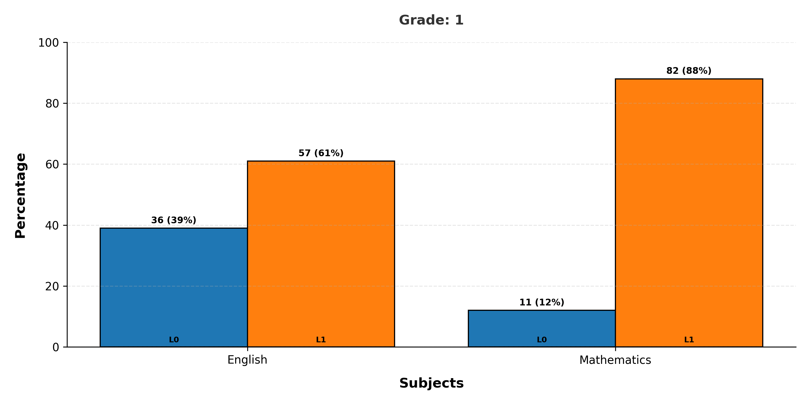
Mastery Levels Analysis - Grade 1
Note: L is Mastery Level

Slide 2
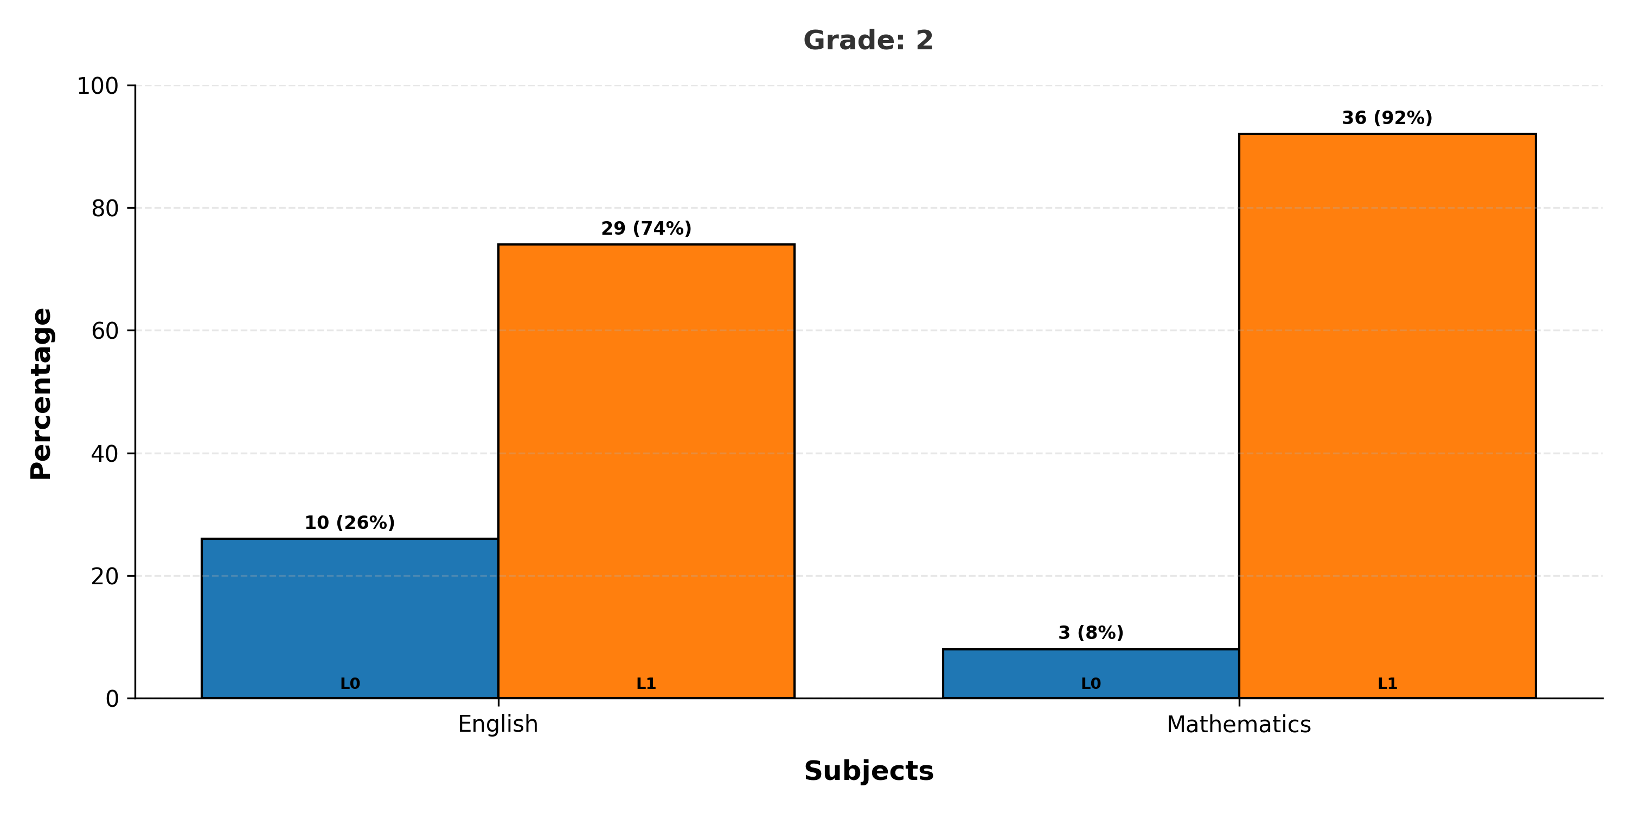
Mastery Levels Analysis - Grade 2
Note: L is Mastery Level

Slide 3
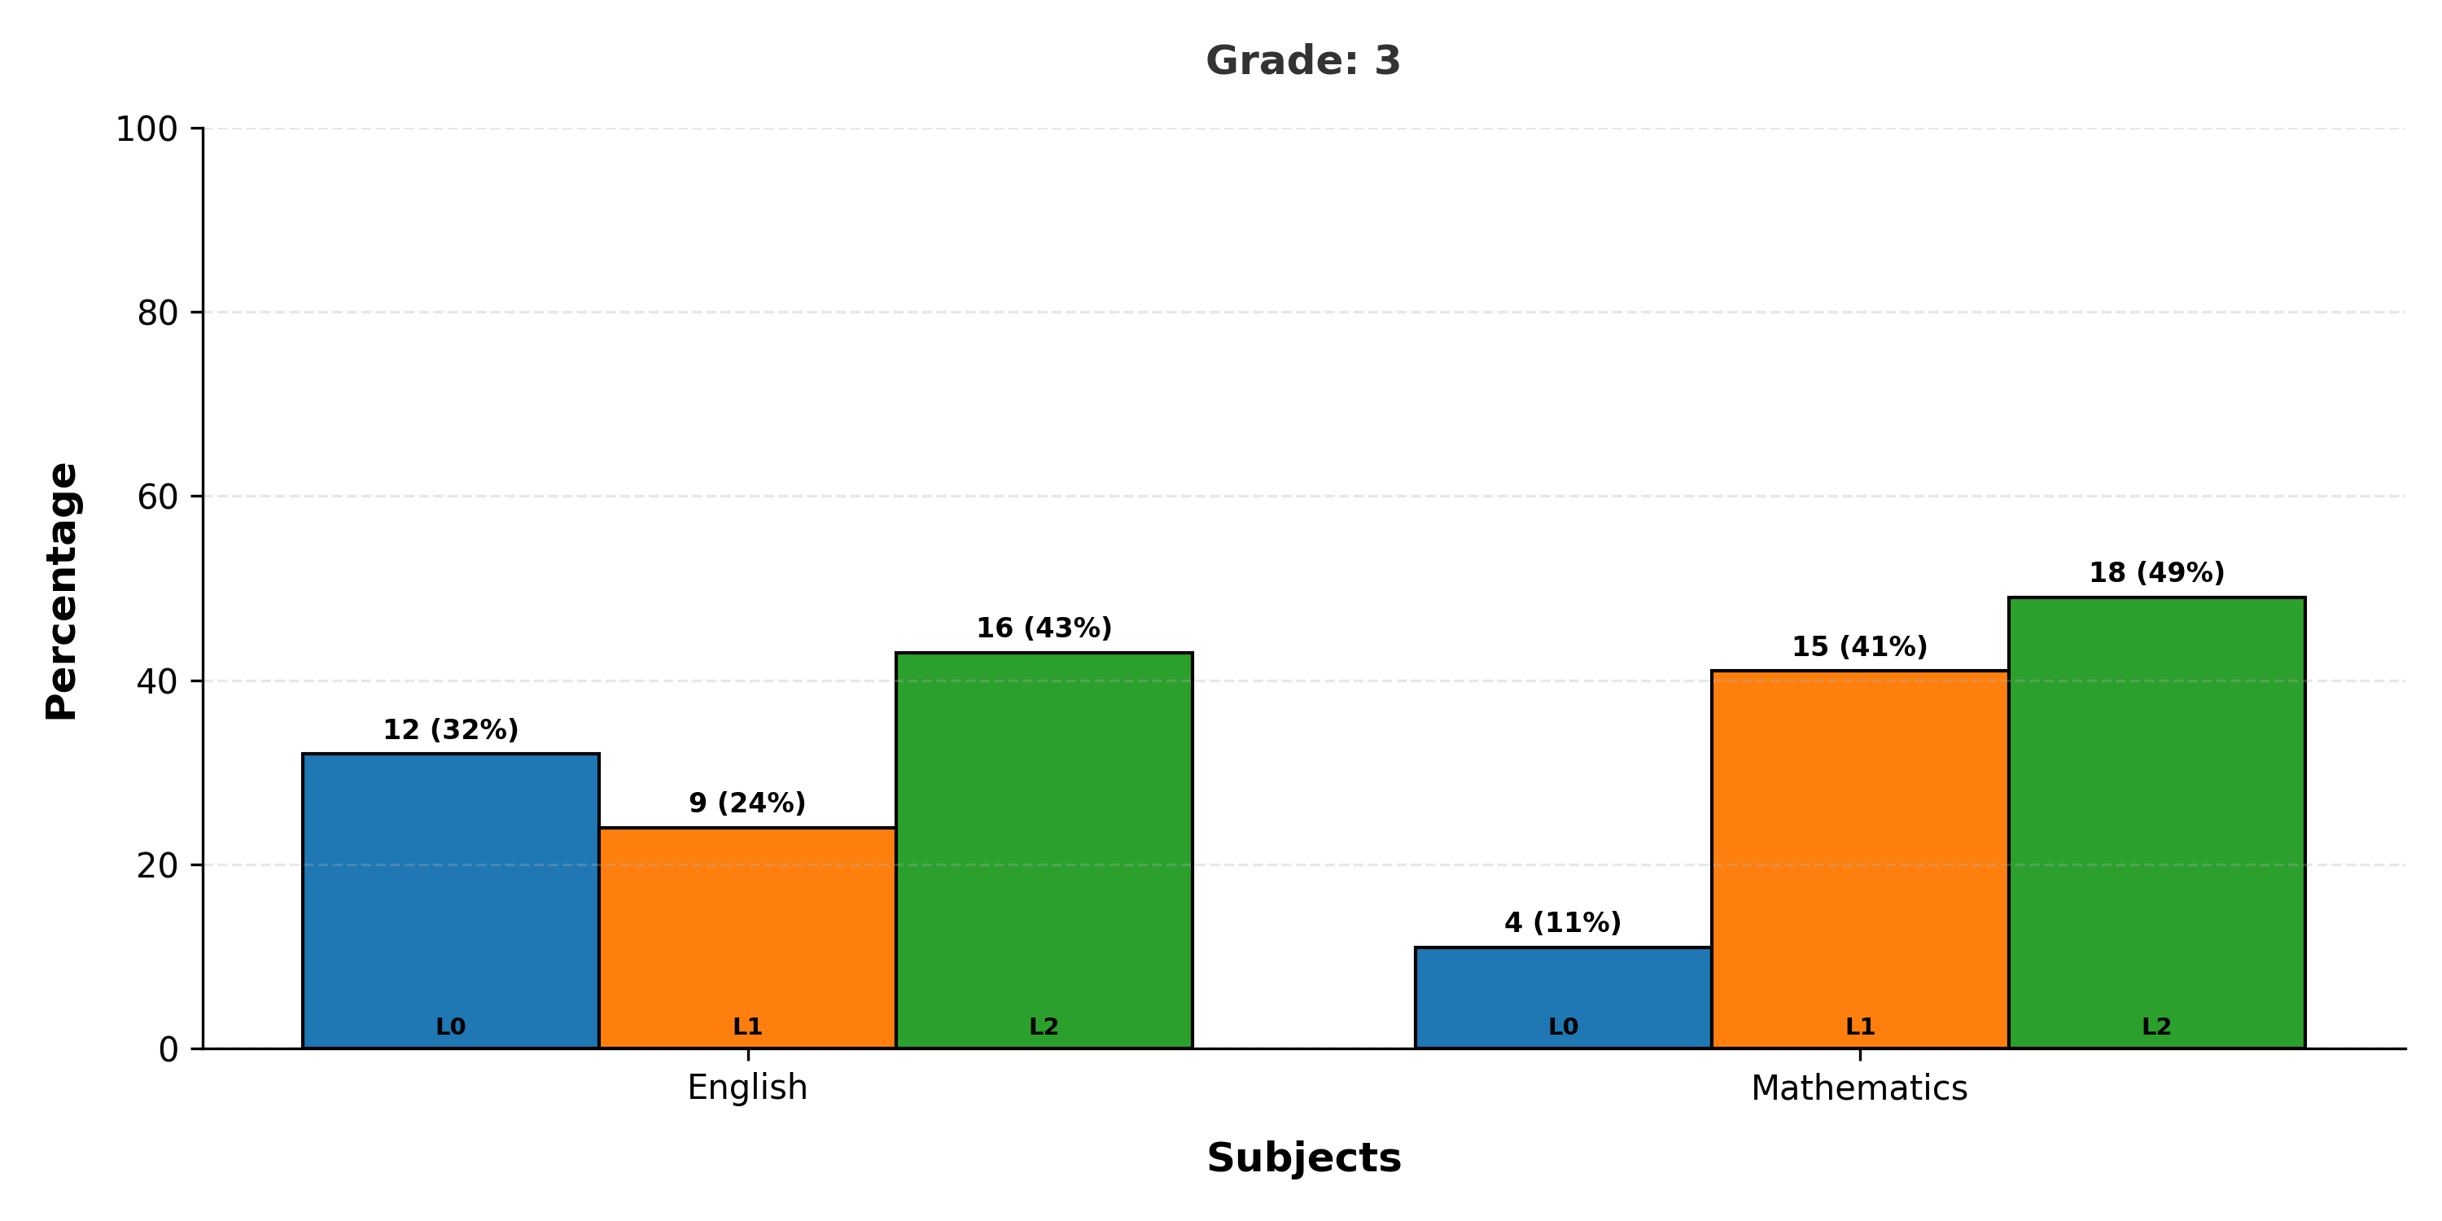
Mastery Levels Analysis - Grade 3
Note: L is Mastery Level

Slide 4
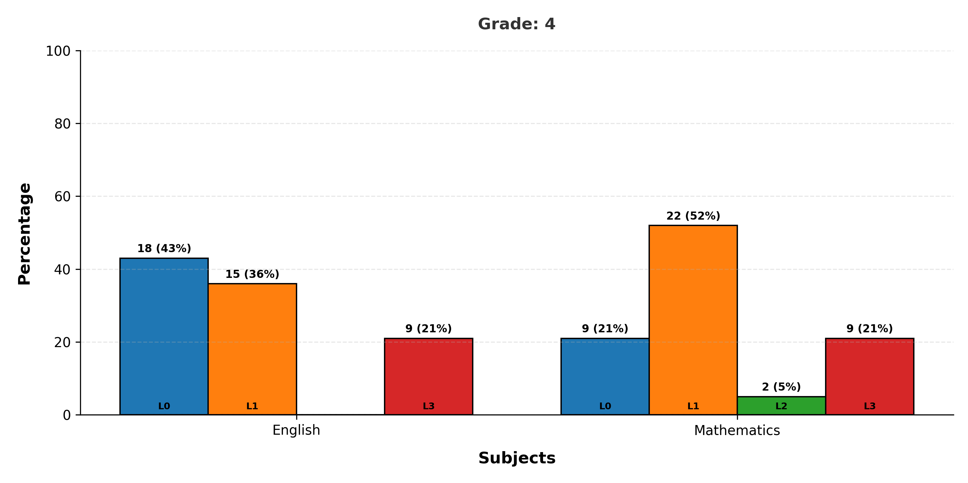
Mastery Levels Analysis - Grade 4
Note: L is Mastery Level

Slide 5
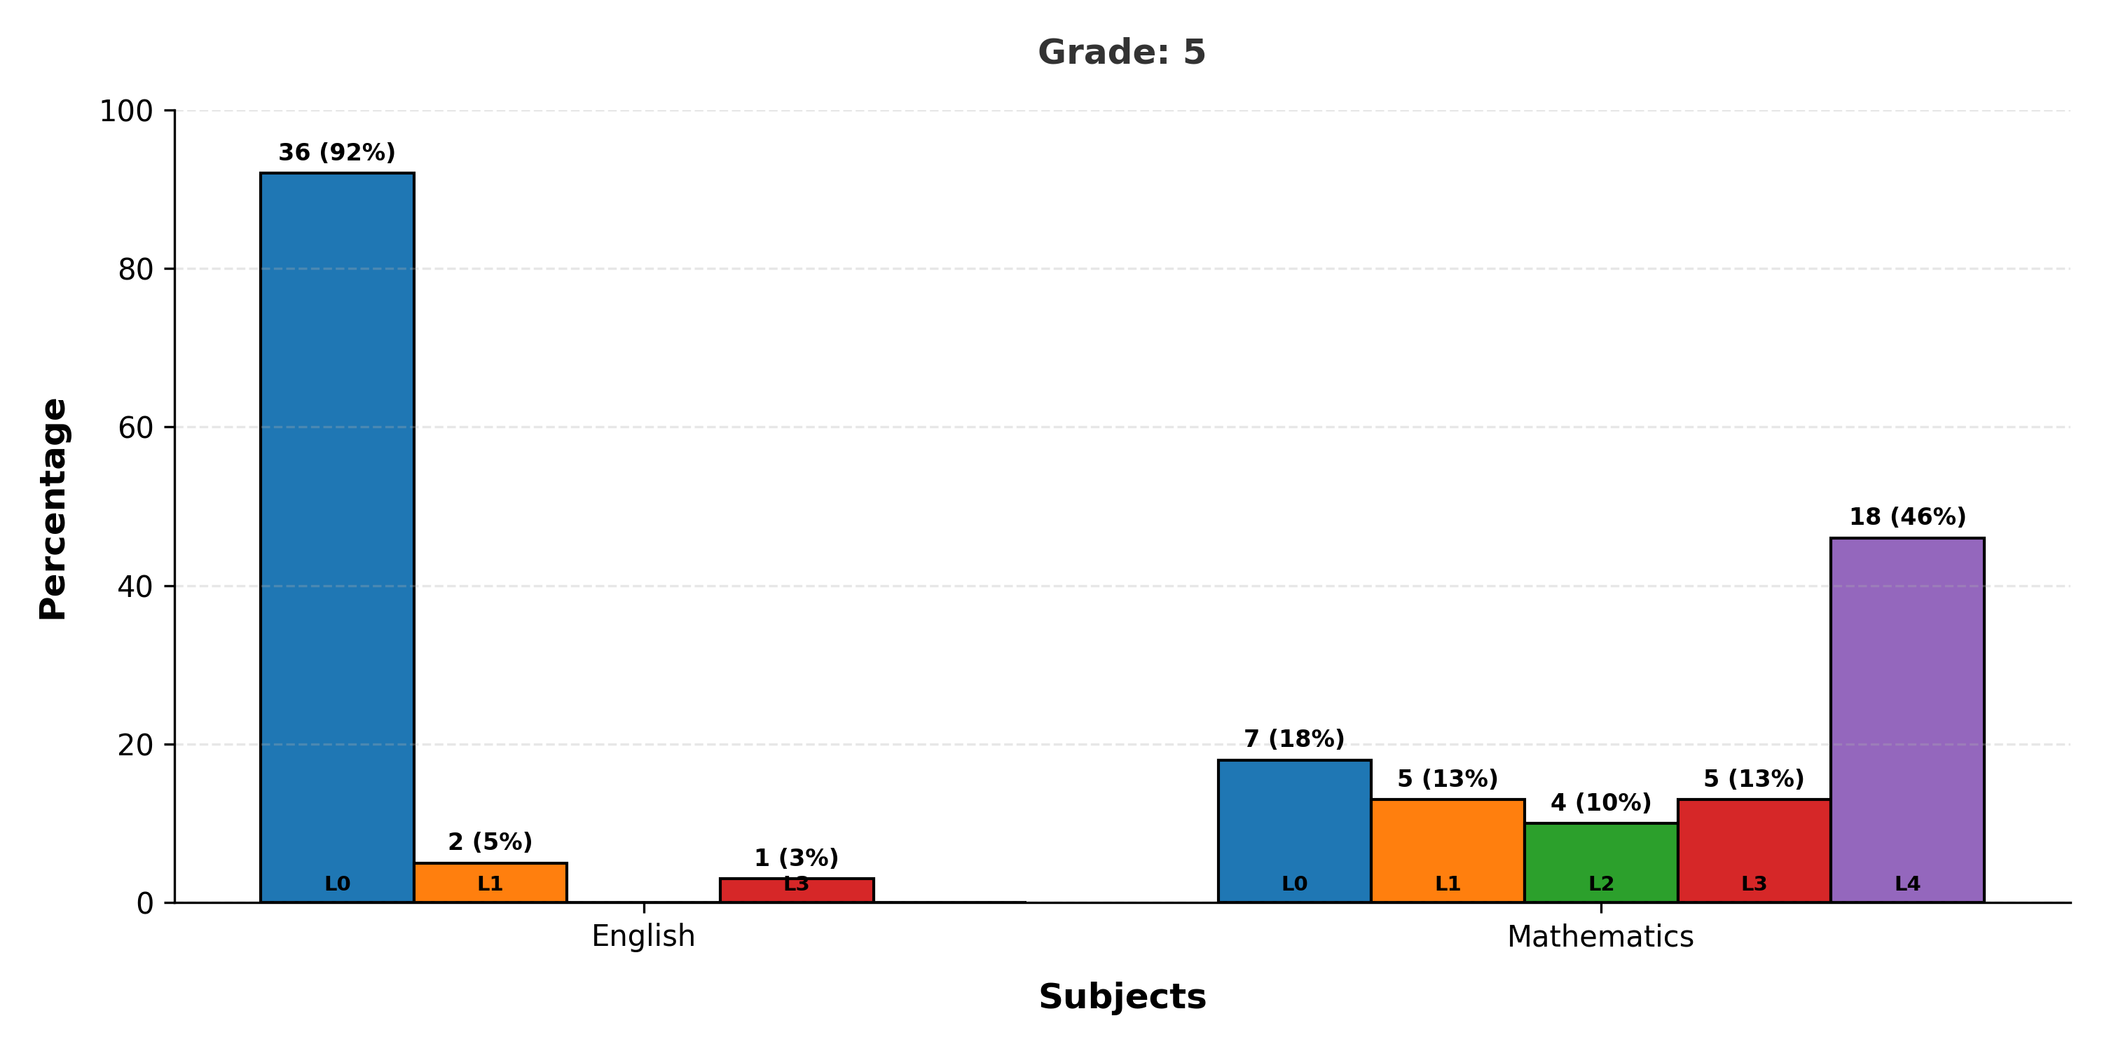
Mastery Levels Analysis - Grade 5
Note: L is Mastery Level

Slide 6
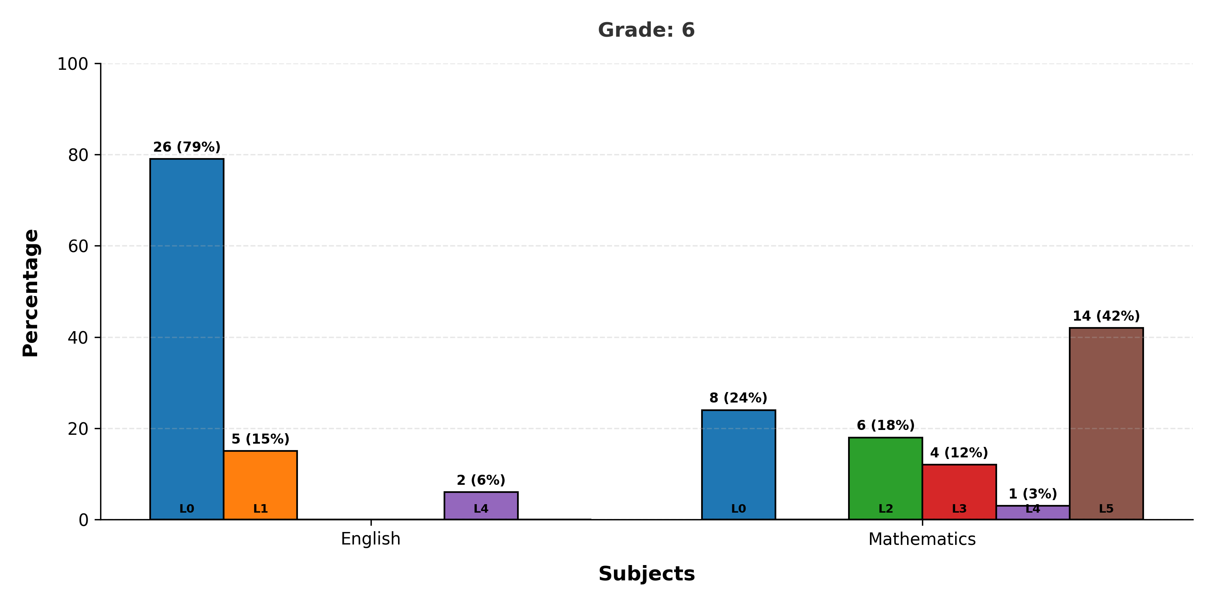
Mastery Levels Analysis - Grade 6
Note: L is Mastery Level

Slide 7
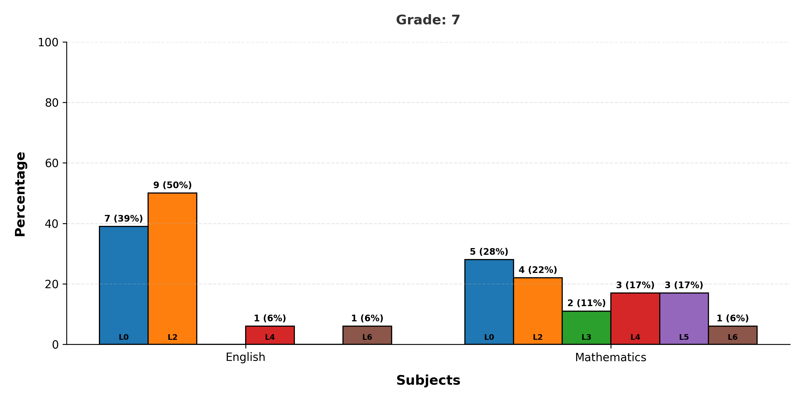
Mastery Levels Analysis - Grade 7
Note: L is Mastery Level

Slide 8
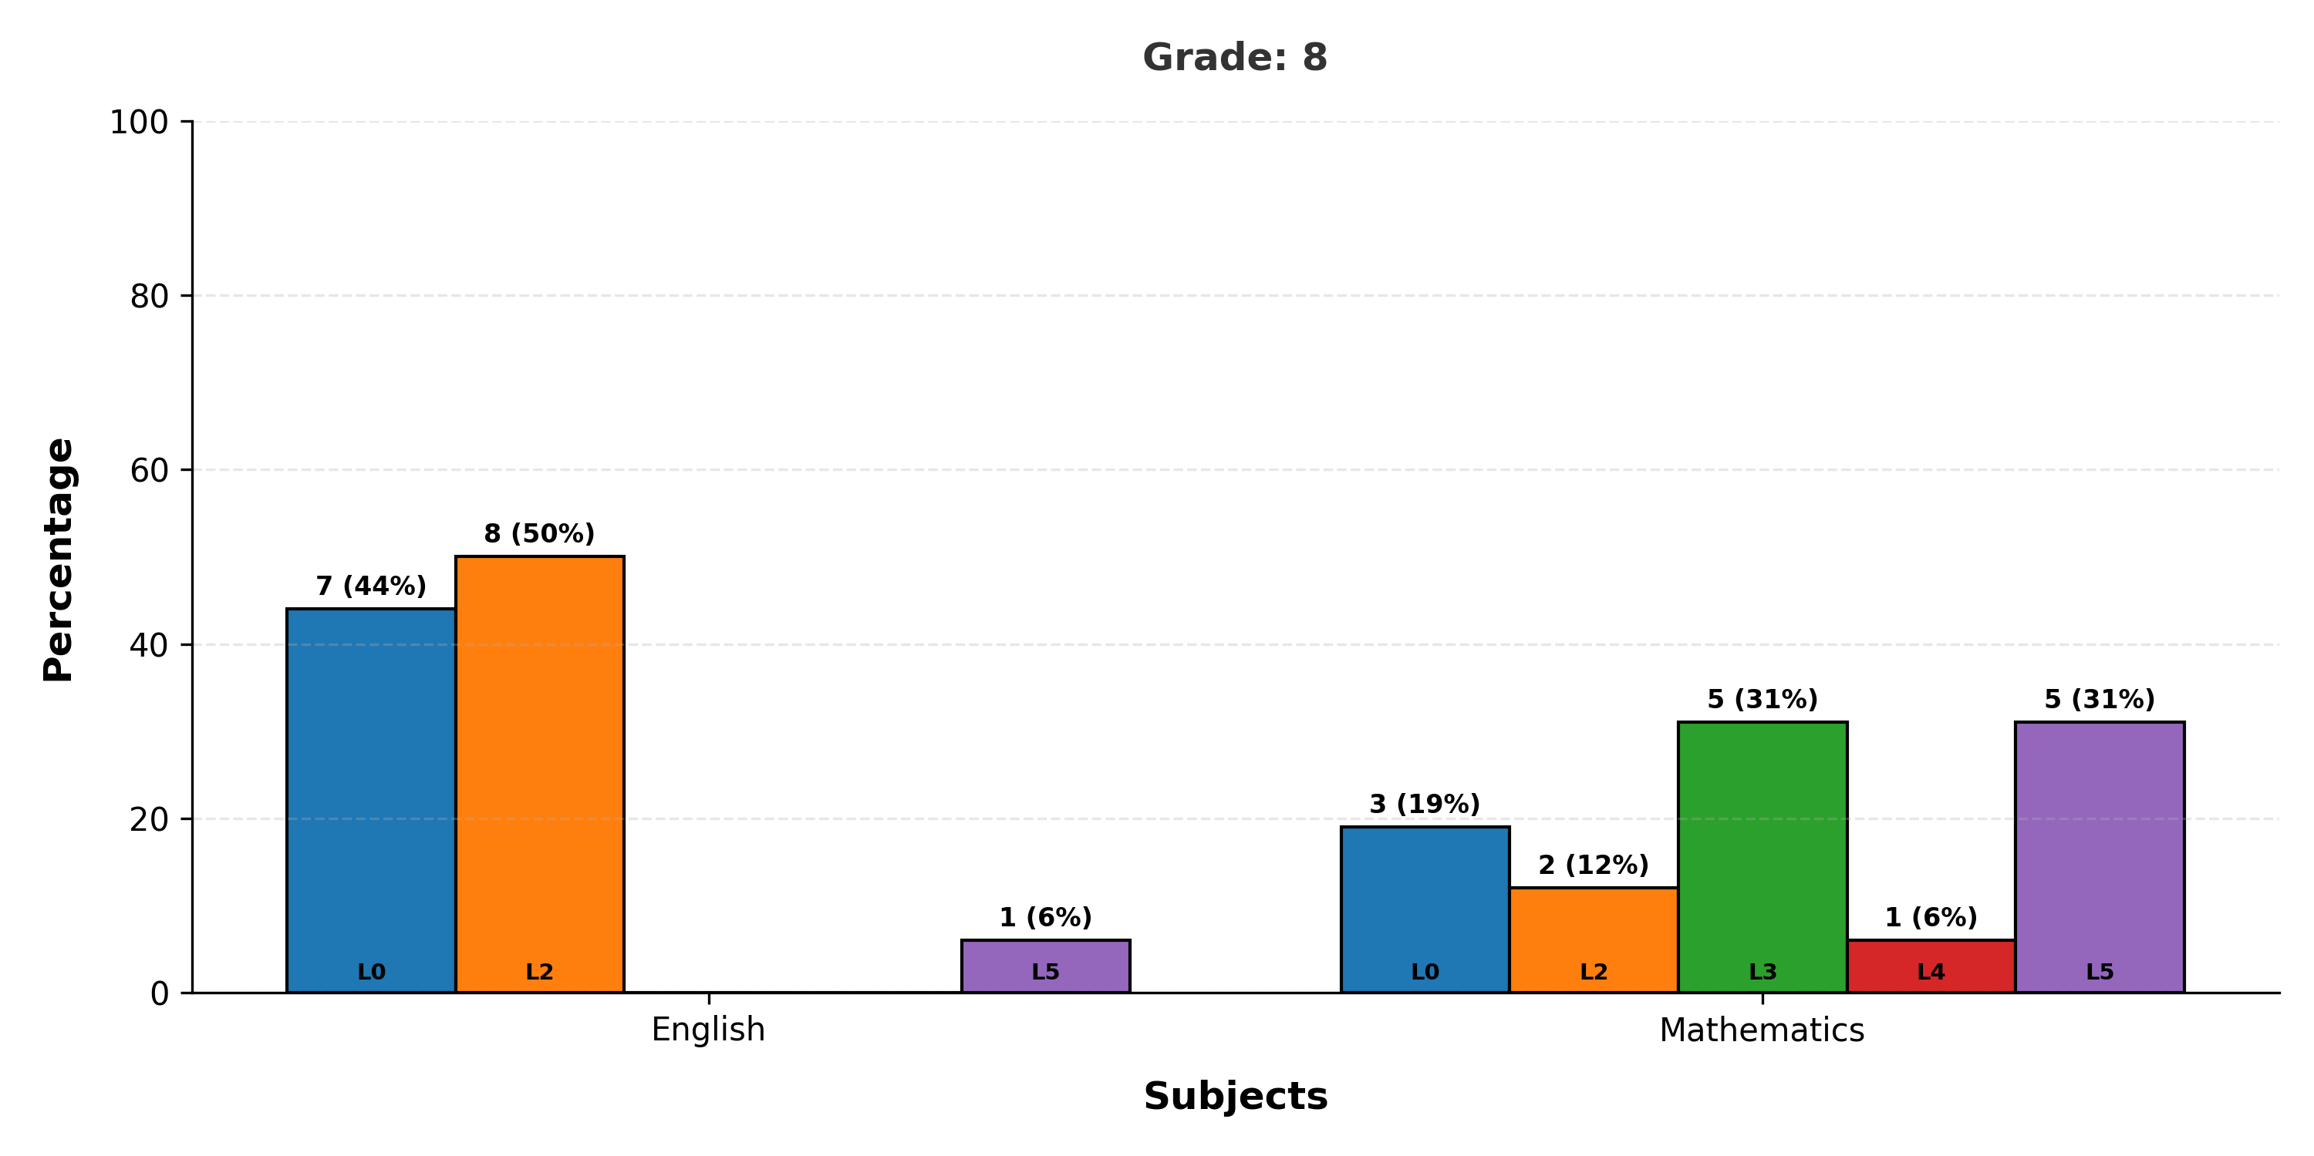
Mastery Levels Analysis - Grade 8
Note: L is Mastery Level

Slide 9
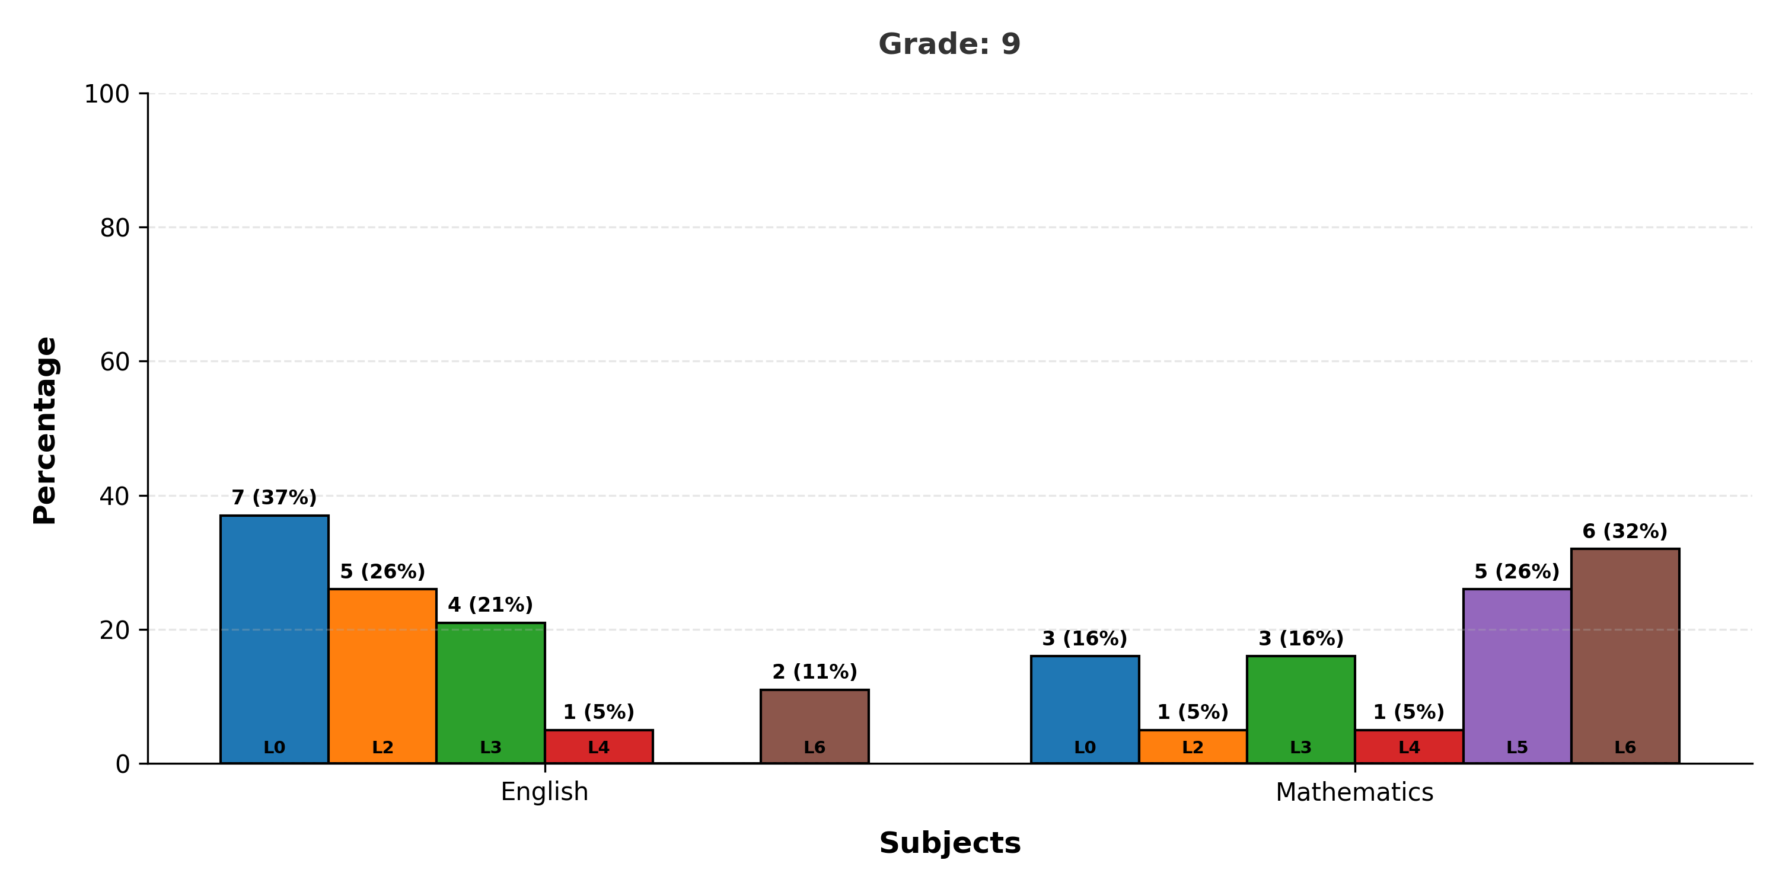
Mastery Levels Analysis - Grade 9
Note: L is Mastery Level

Slide 10
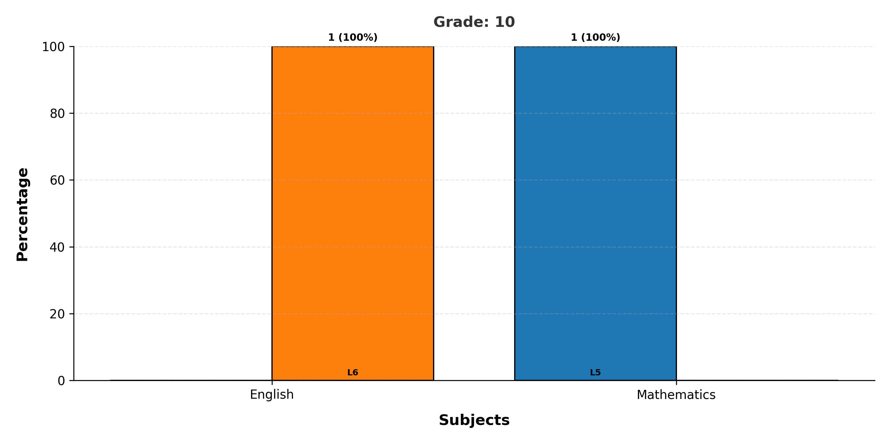
Mastery Levels Analysis - Grade 10
Note: L is Mastery Level

Slide 11
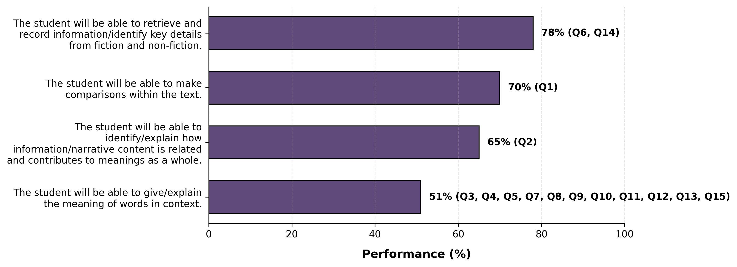
Learning Outcome Performance - Grade 1 - English

Slide 12
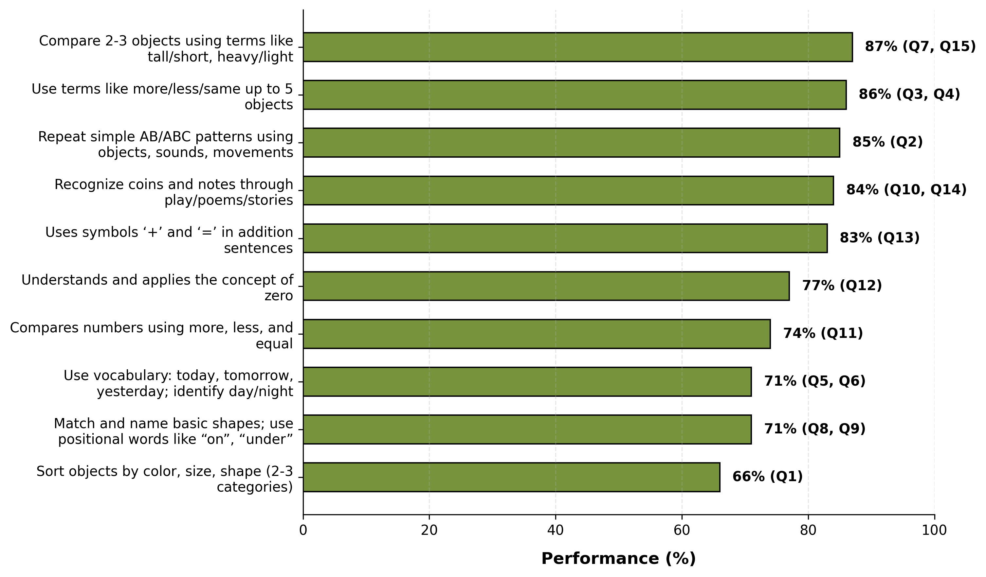
Learning Outcome Performance - Grade 1 - Mathematics

Slide 13
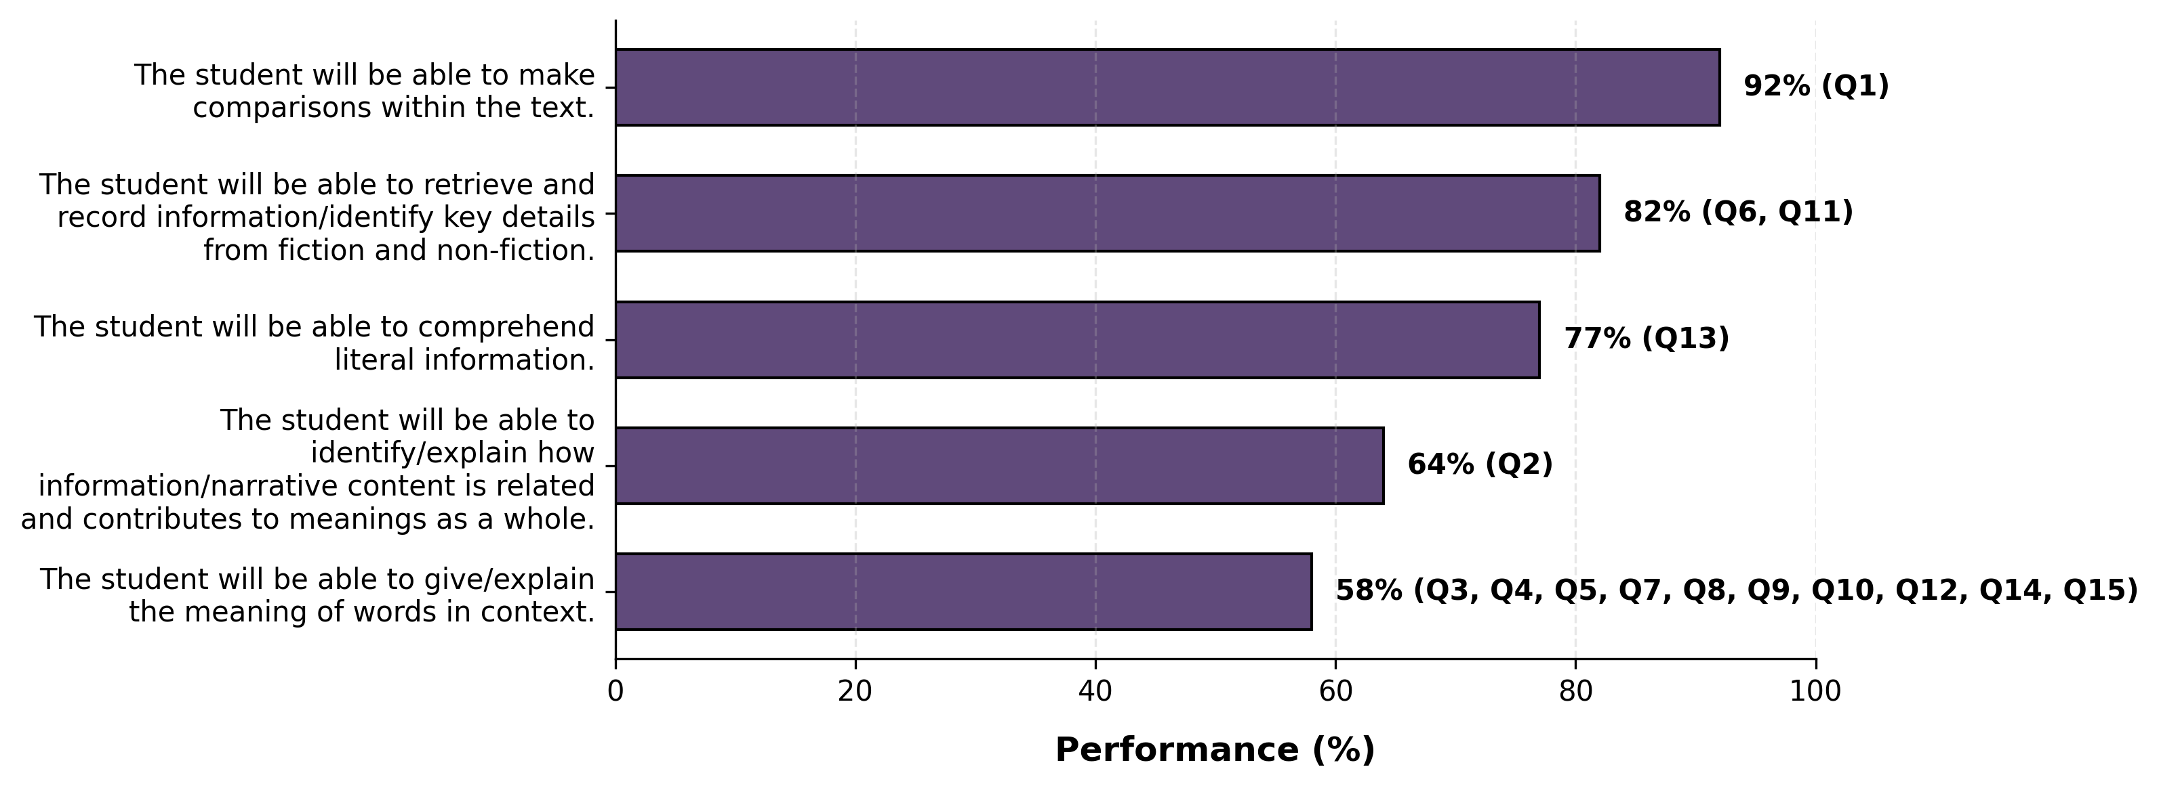
Learning Outcome Performance - Grade 2 - English

Slide 14
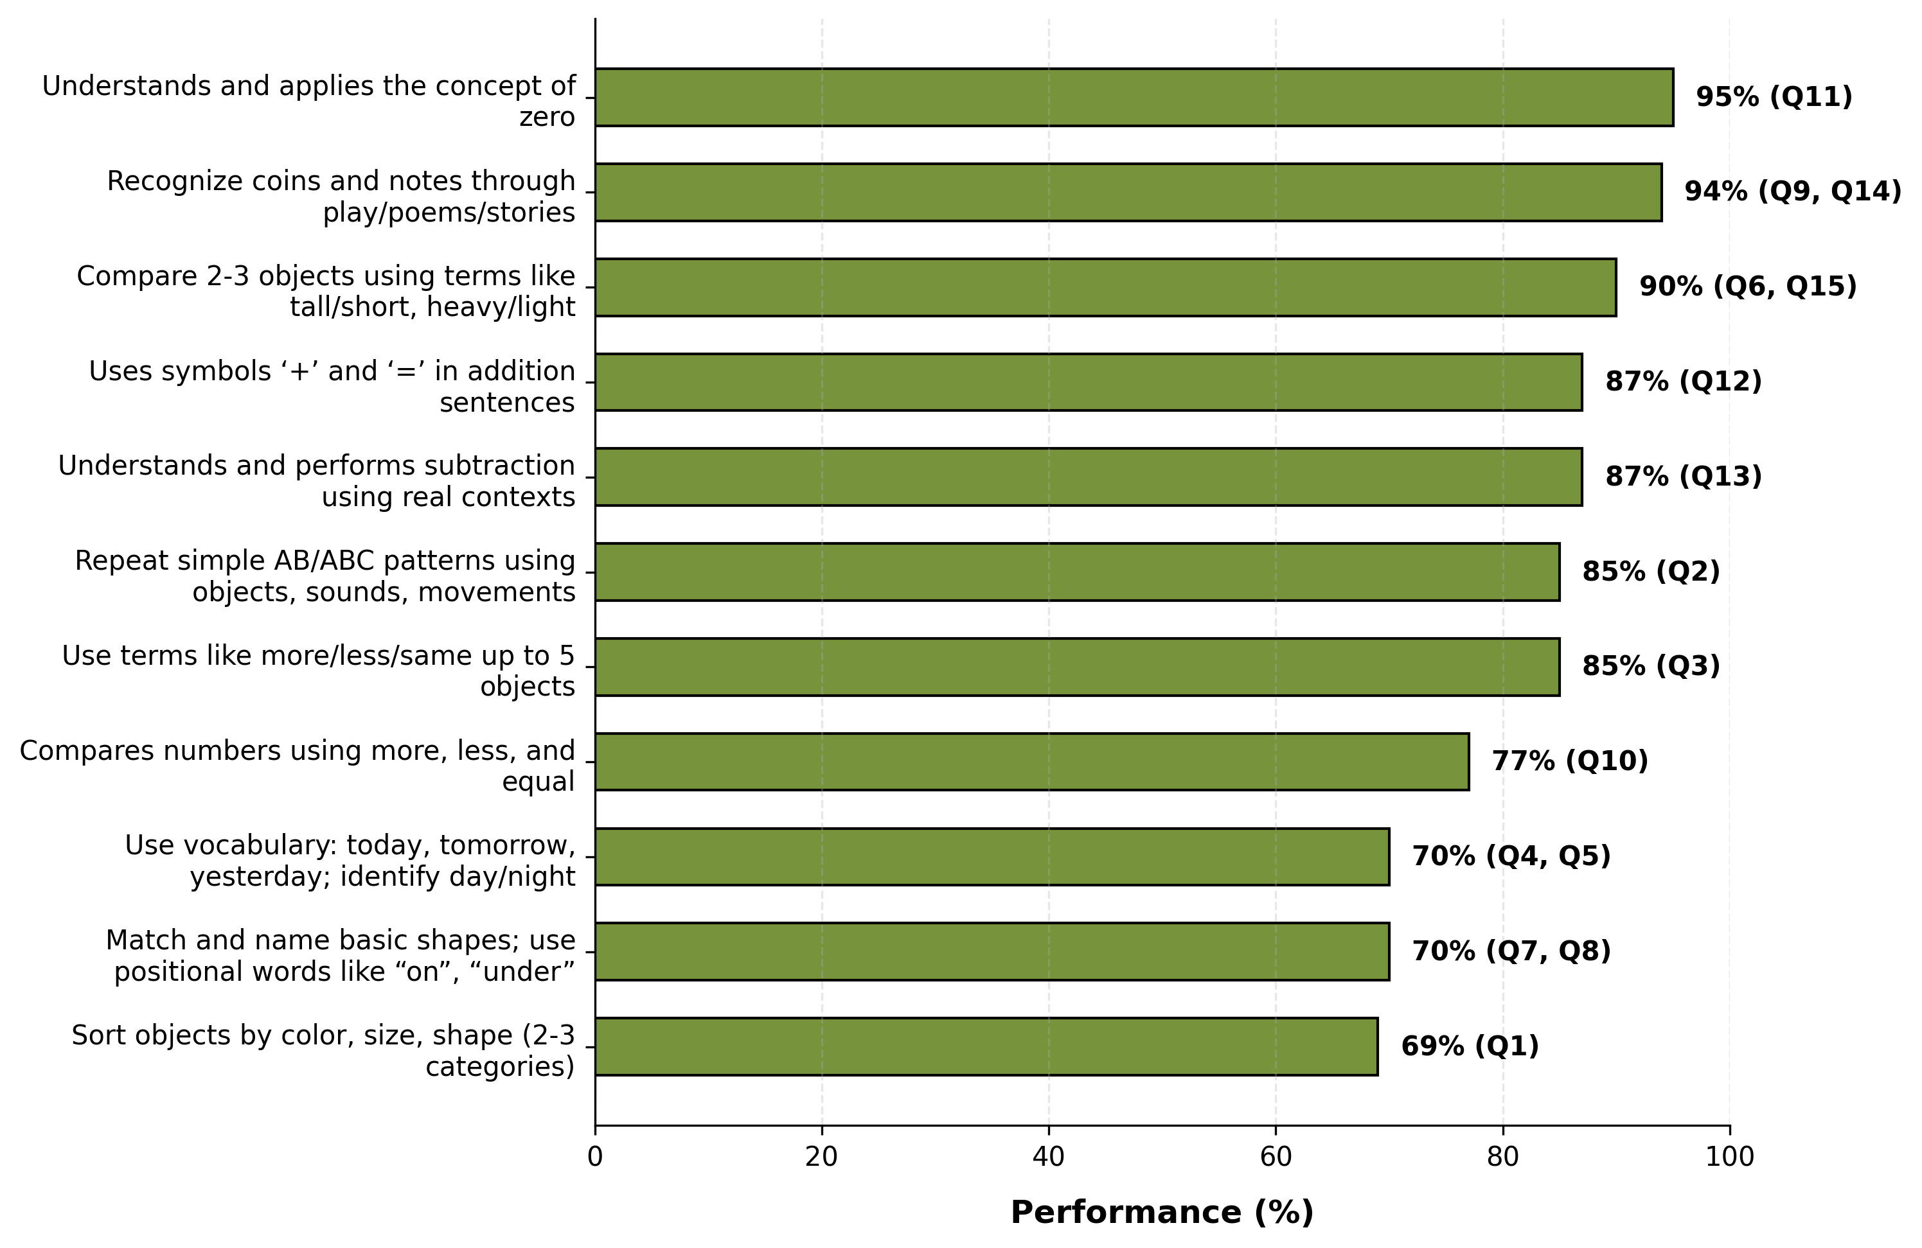
Learning Outcome Performance - Grade 2 - Mathematics

Slide 15
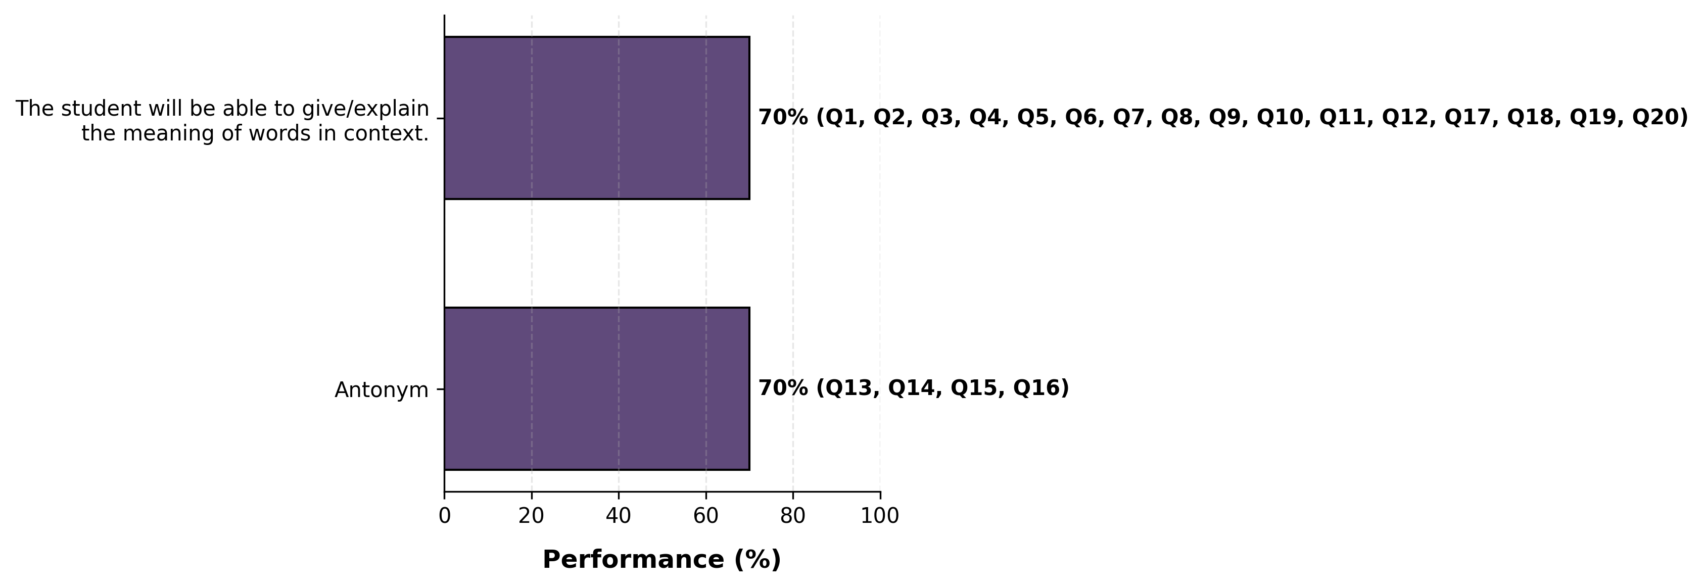
Learning Outcome Performance - Grade 3 - English

Slide 16
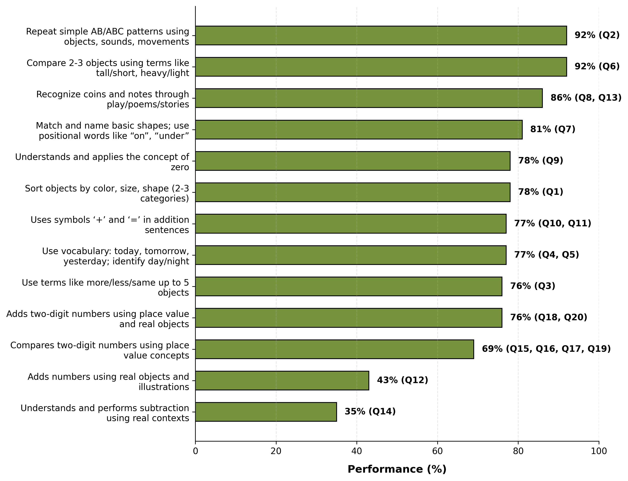
Learning Outcome Performance - Grade 3 - Mathematics

Slide 17
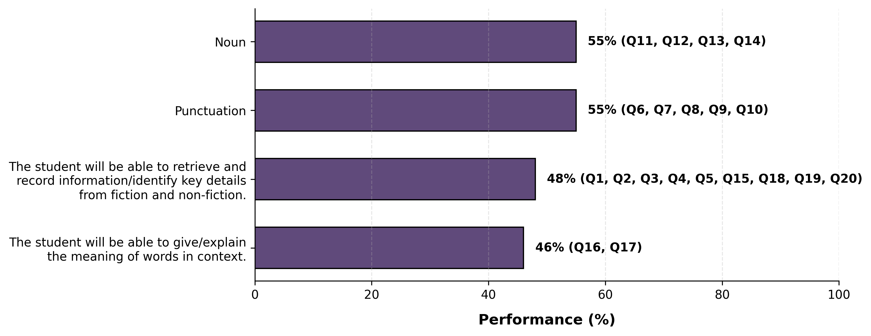
Learning Outcome Performance - Grade 4 - English

Slide 18
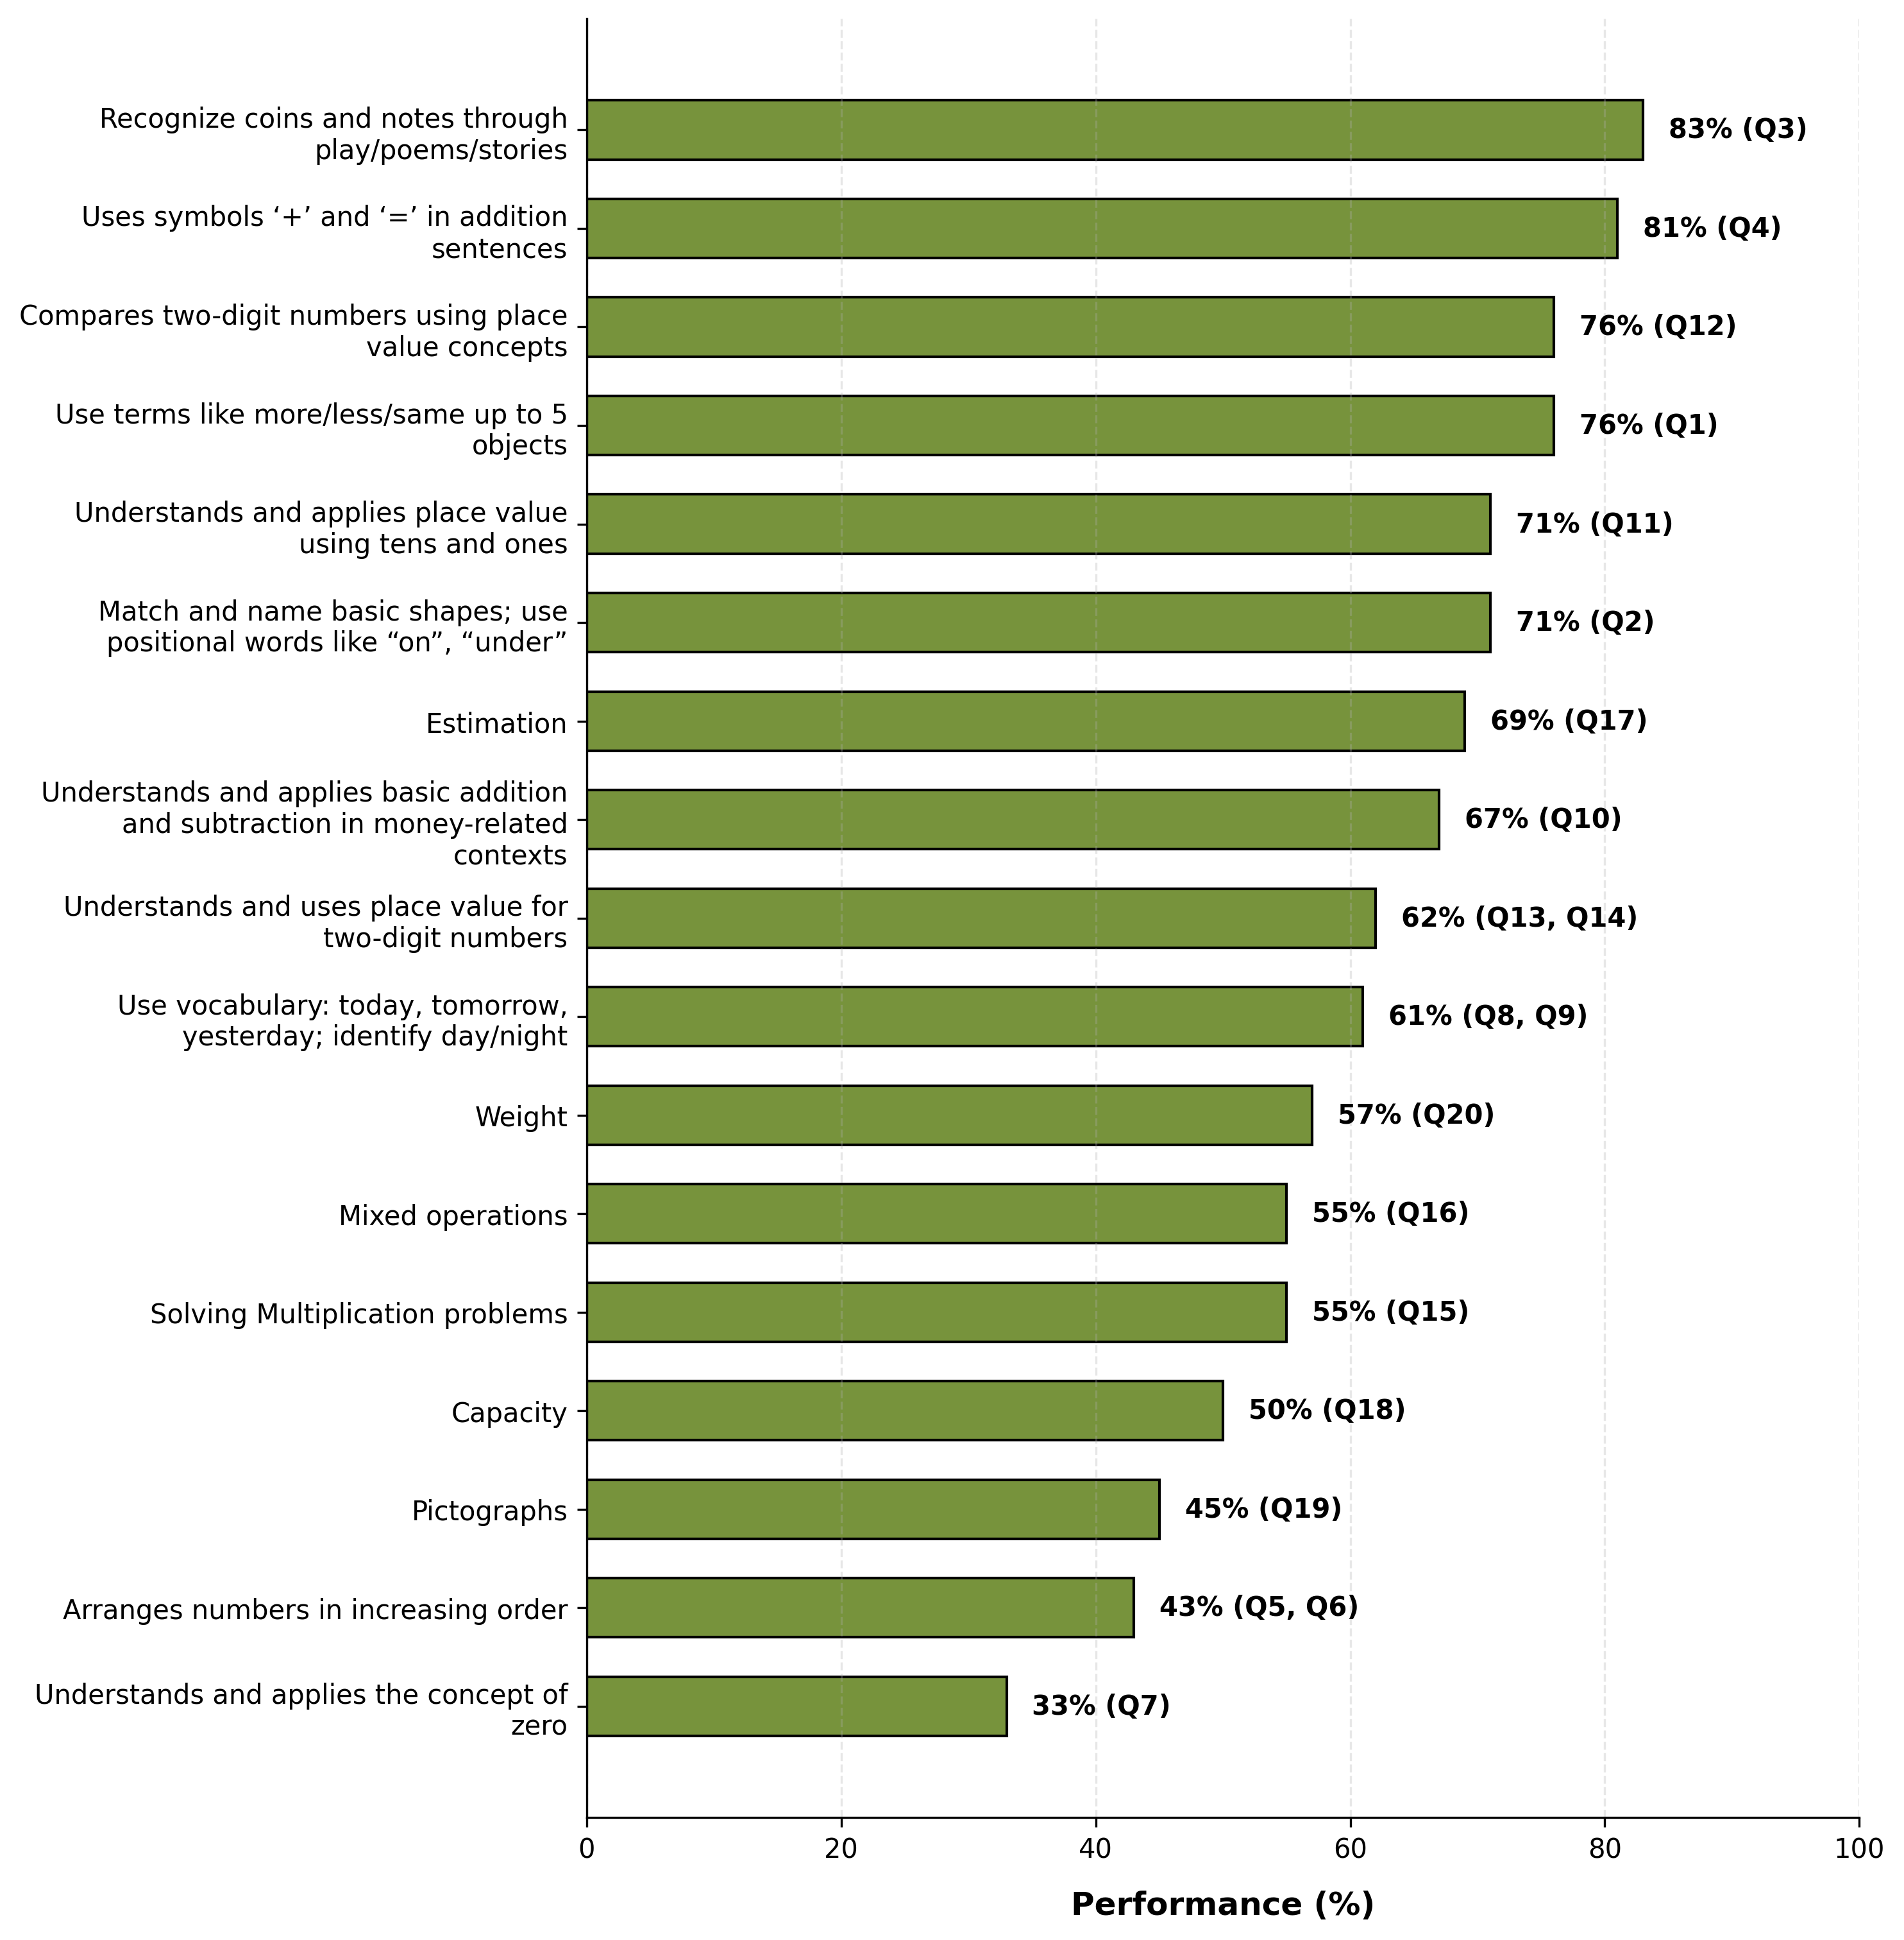
Learning Outcome Performance - Grade 4 - Mathematics

Slide 19
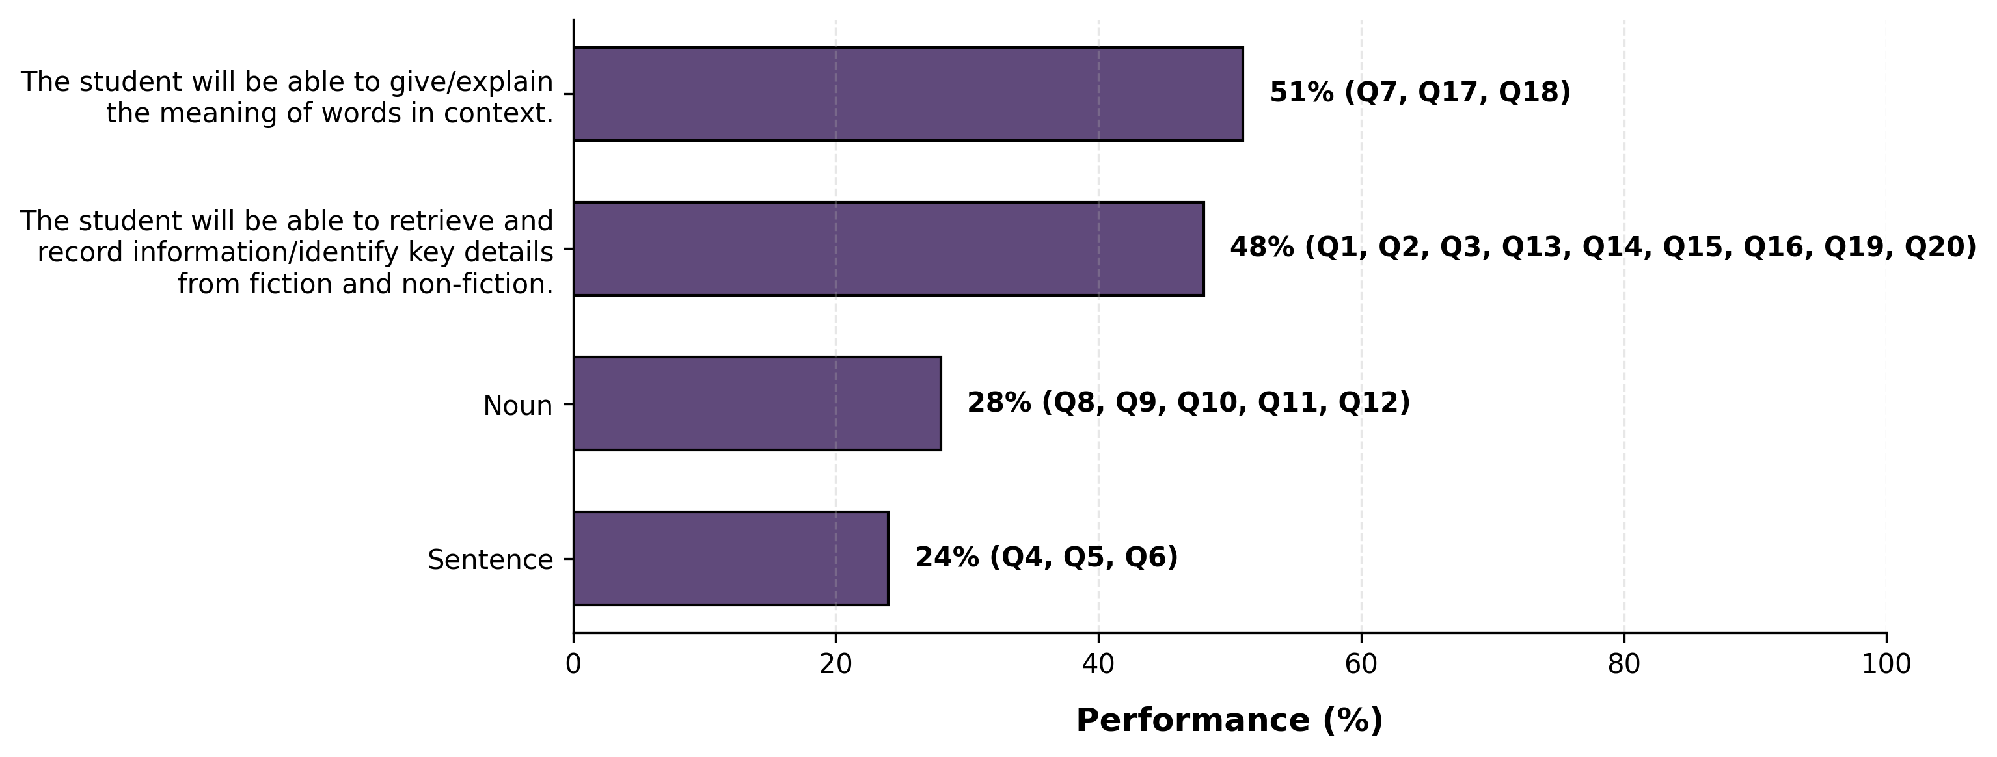
Learning Outcome Performance - Grade 5 - English

Slide 20
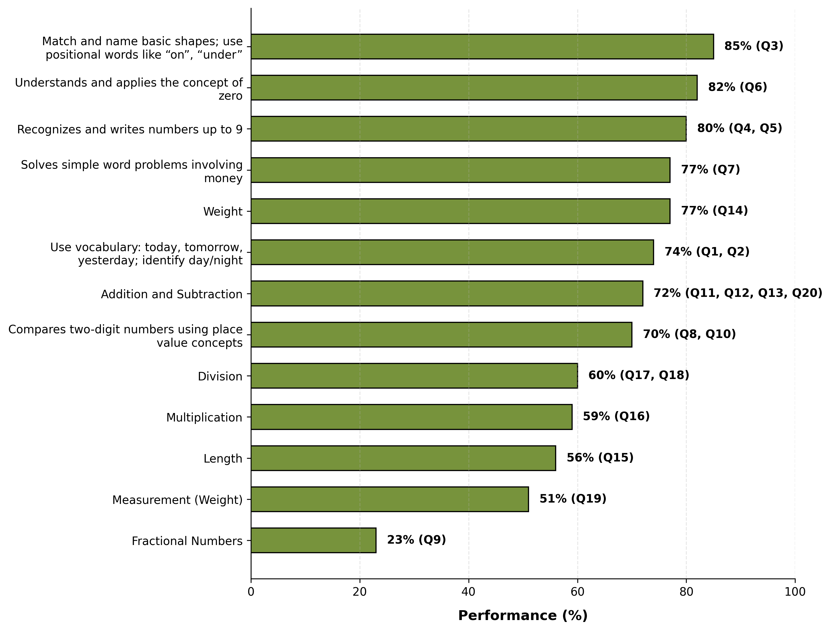
Learning Outcome Performance - Grade 5 - Mathematics

Slide 21
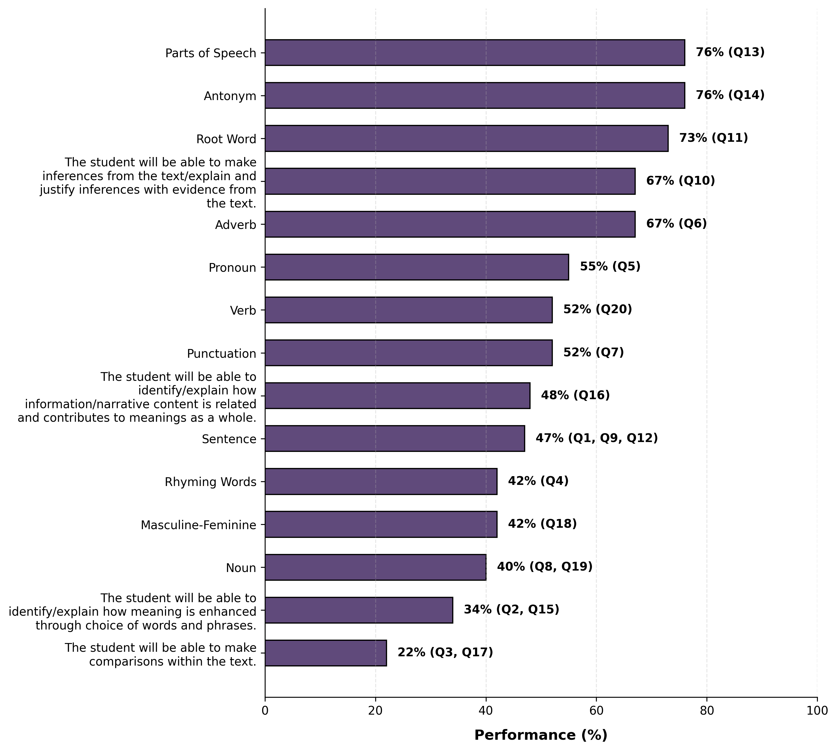
Learning Outcome Performance - Grade 6 - English

Slide 22
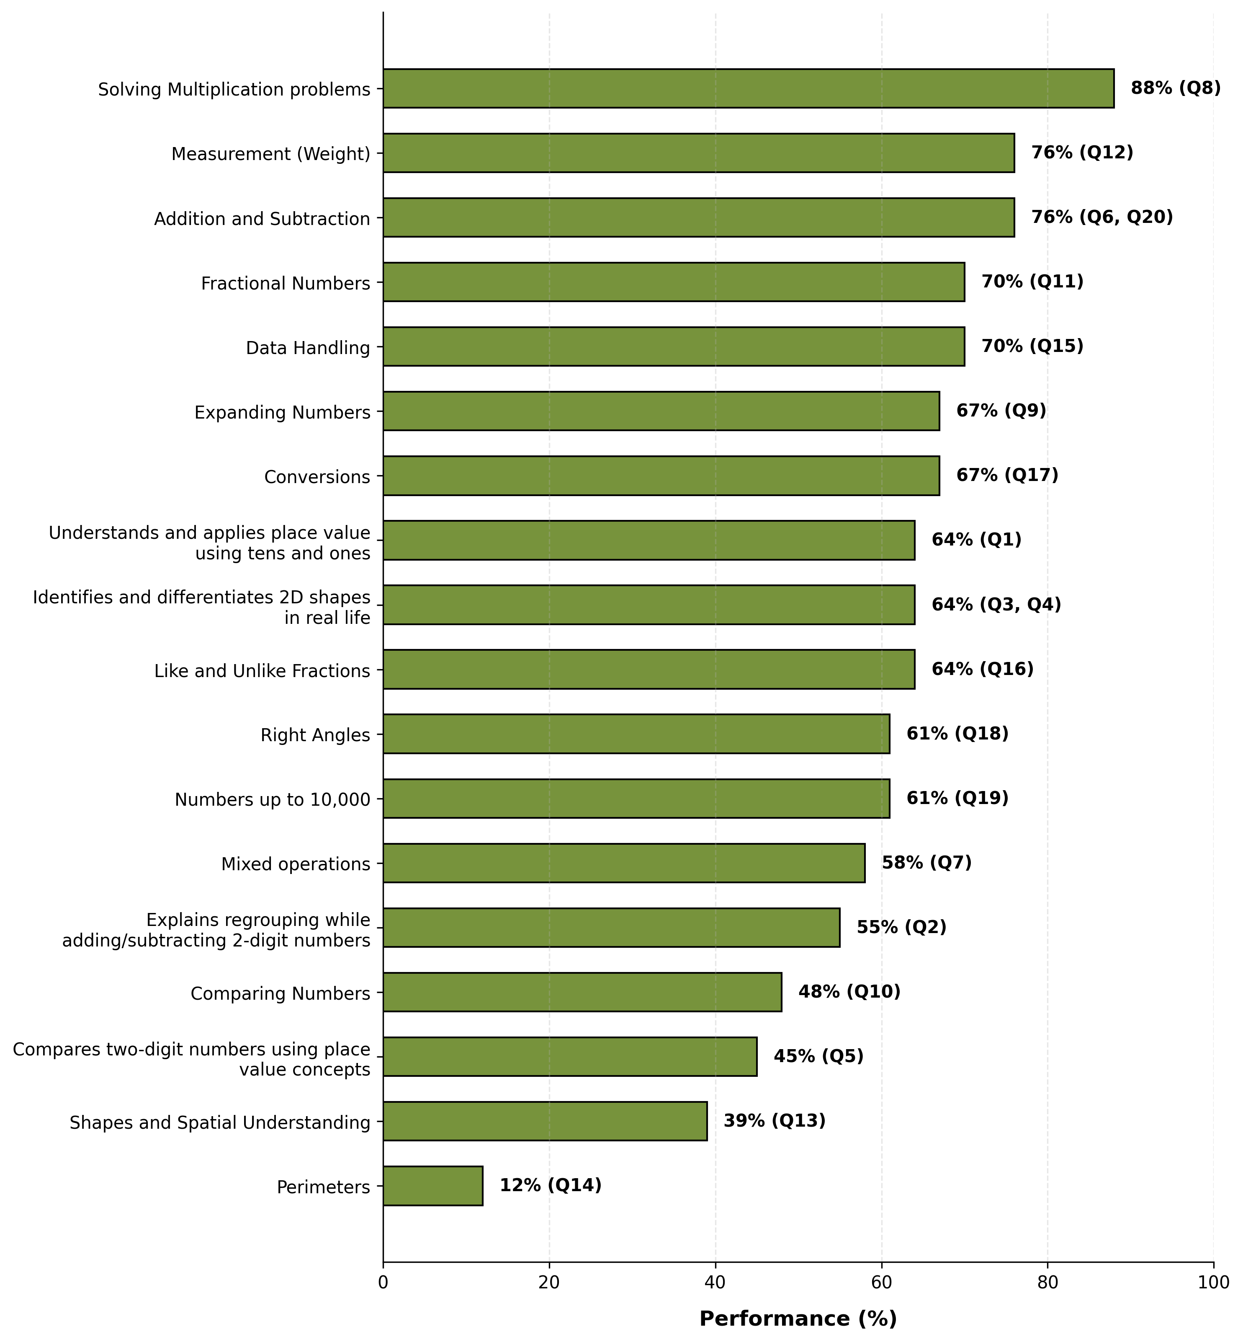
Learning Outcome Performance - Grade 6 - Mathematics

Slide 23
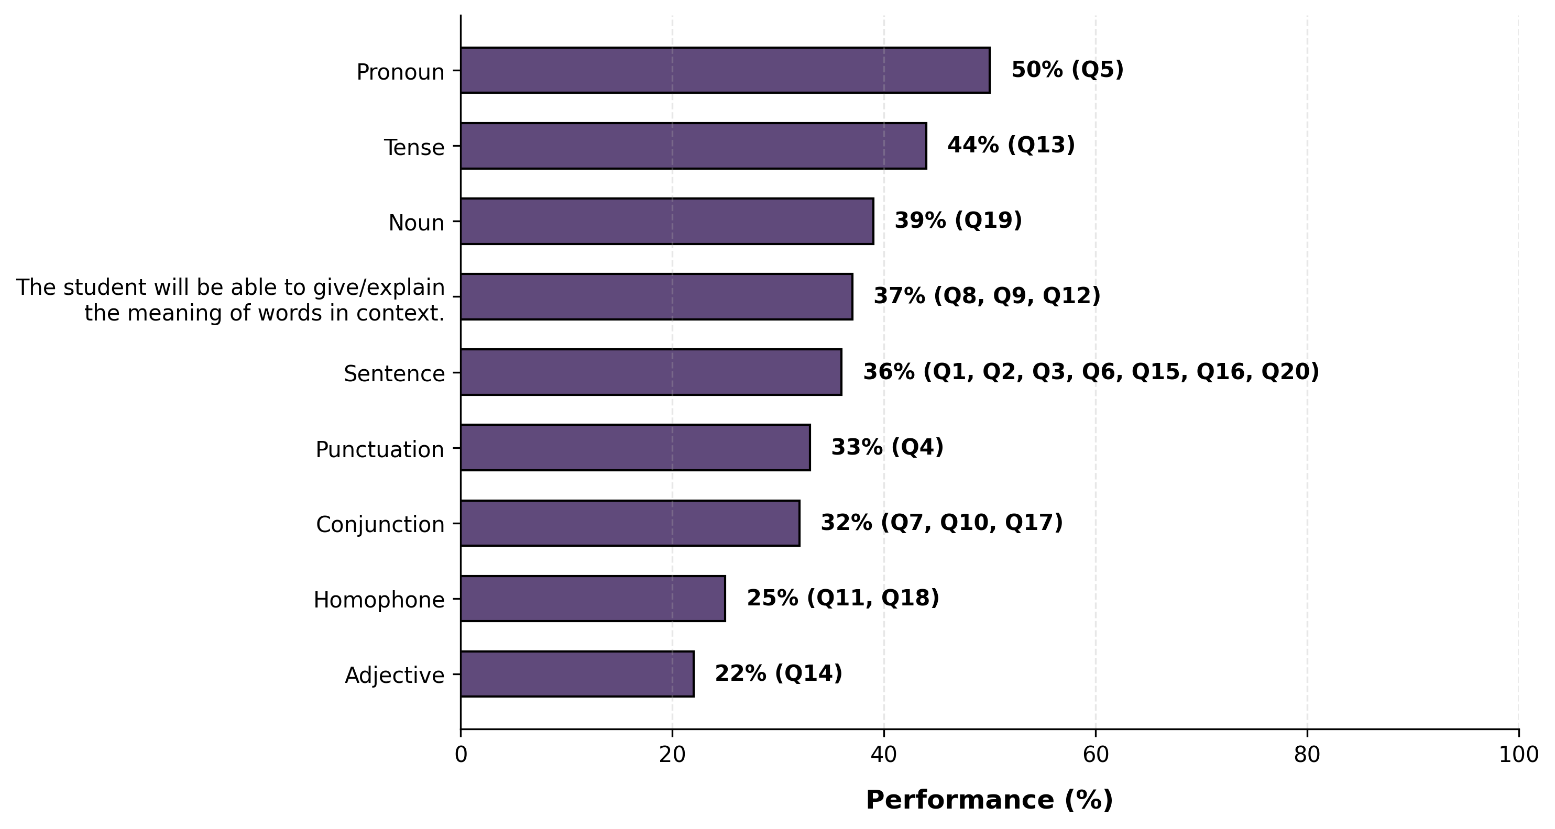
Learning Outcome Performance - Grade 7 - English

Slide 24
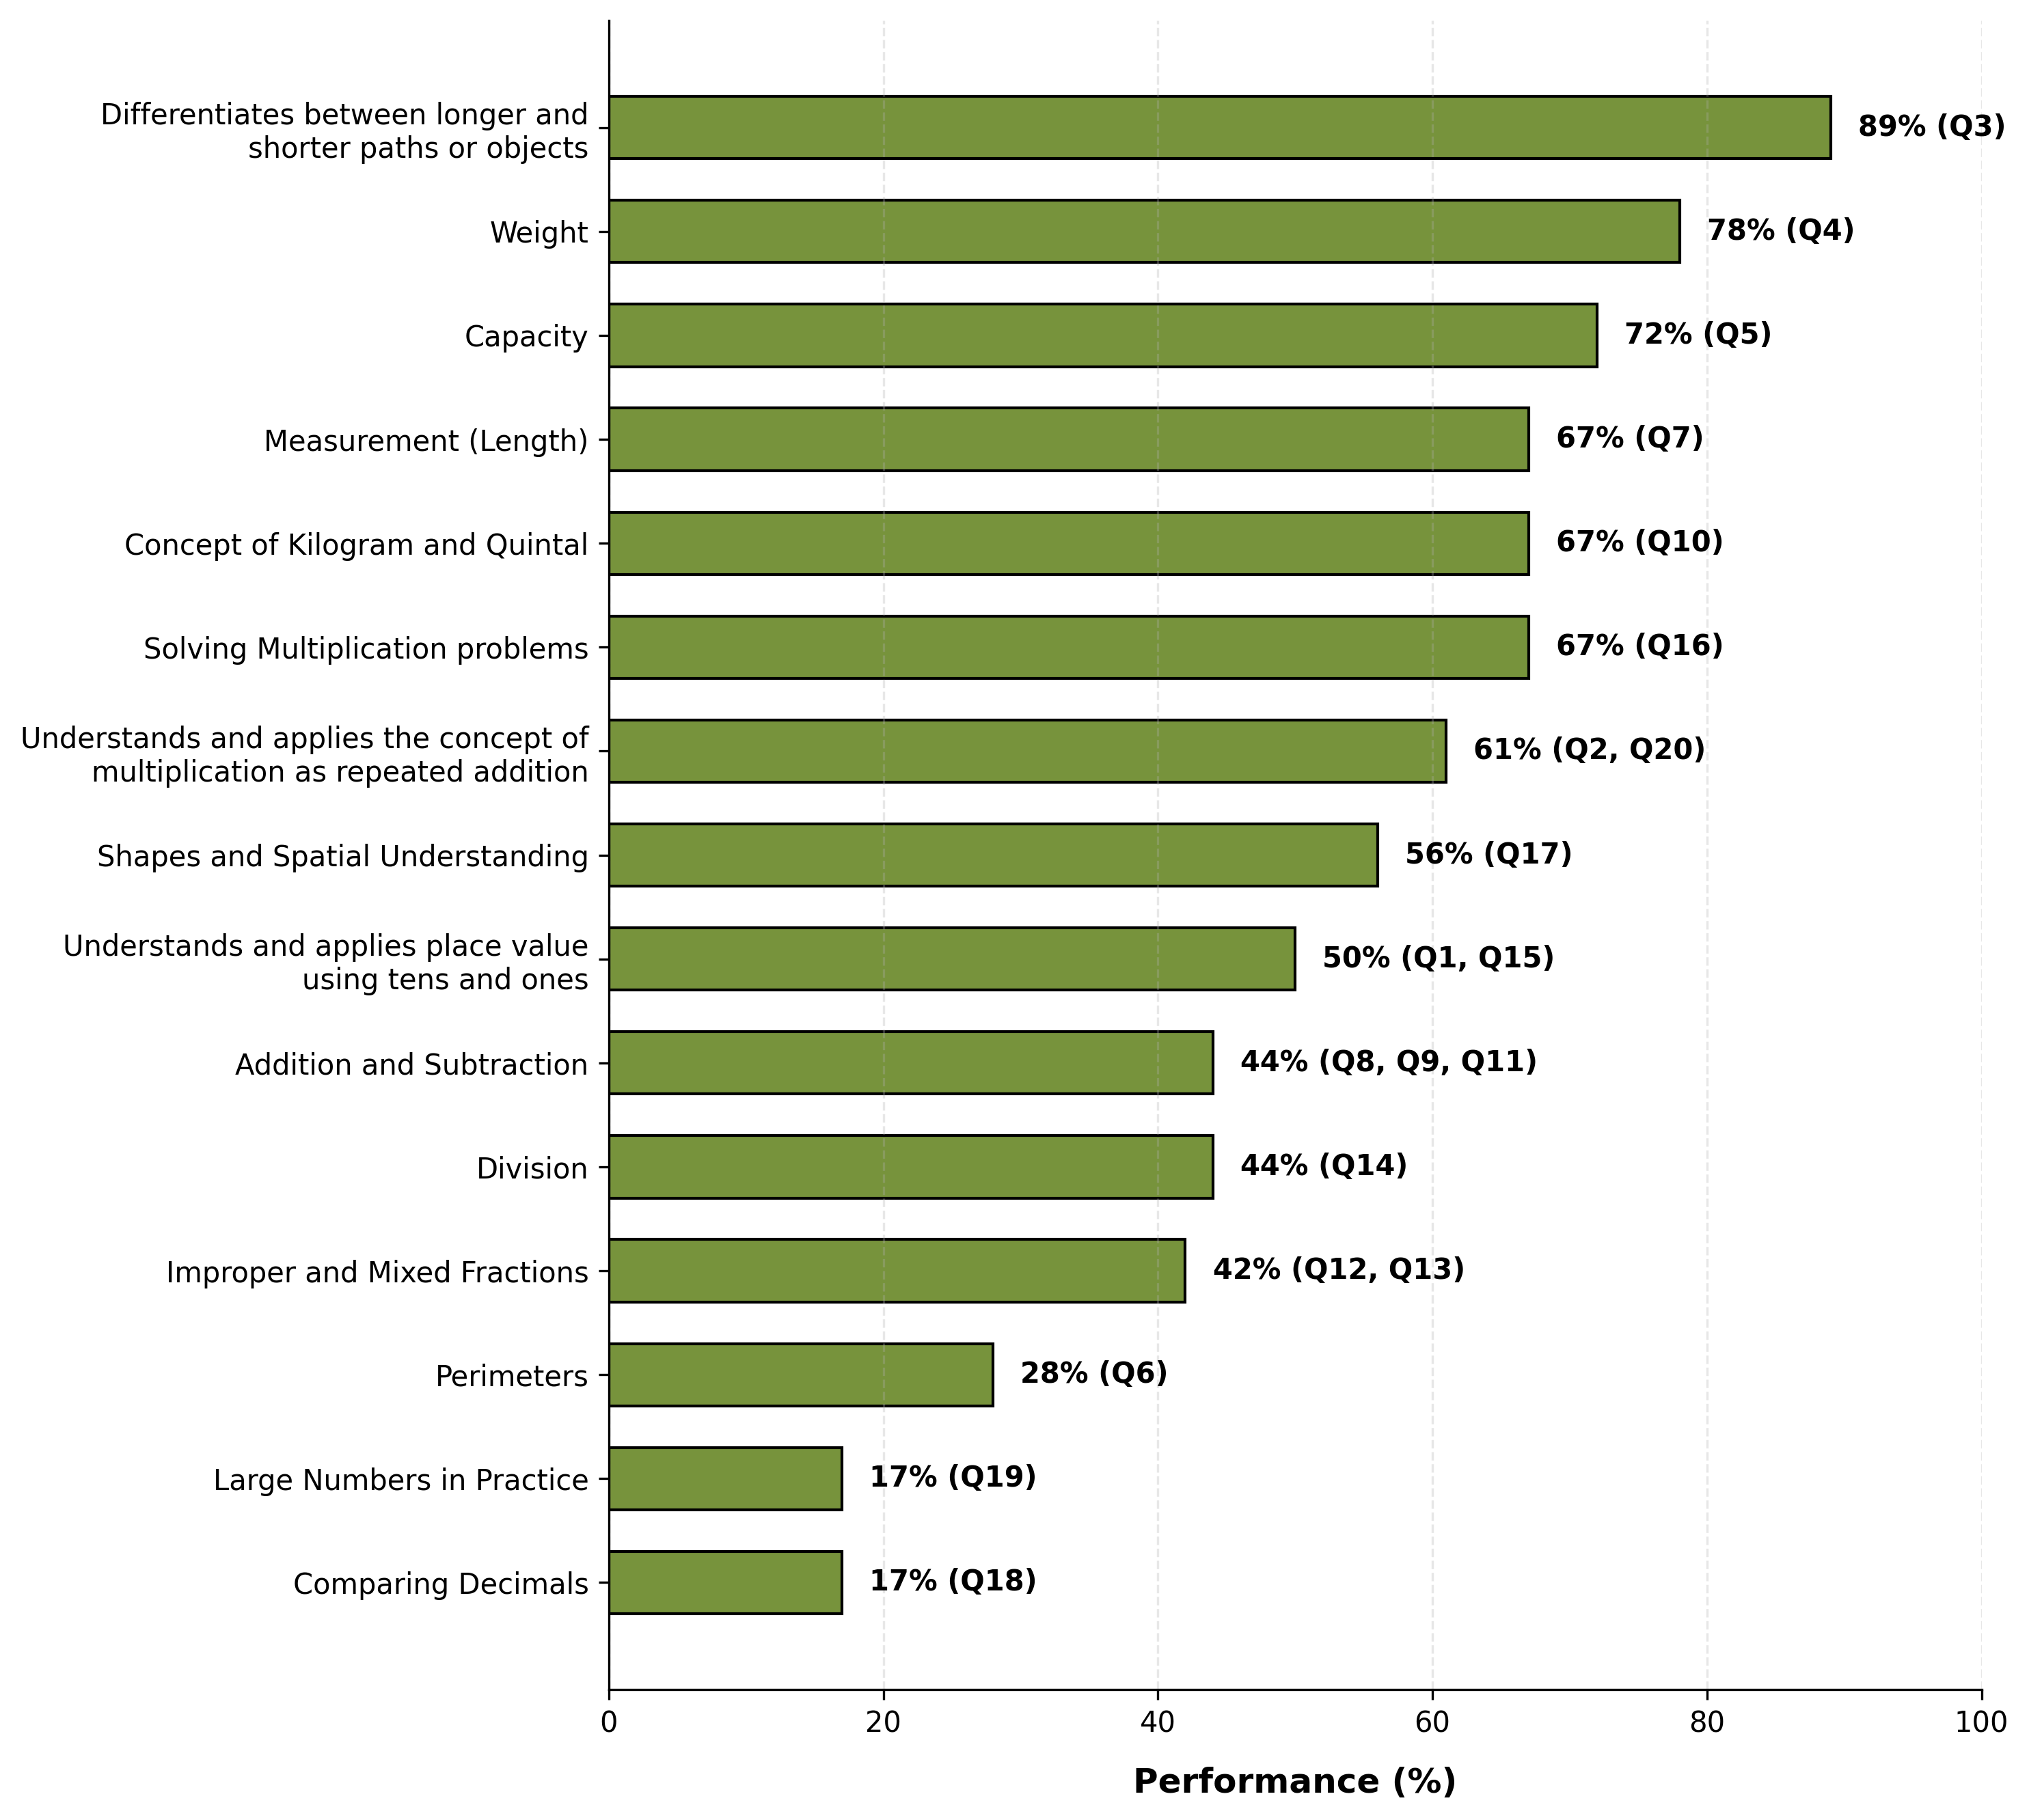
Learning Outcome Performance - Grade 7 - Mathematics

Slide 25
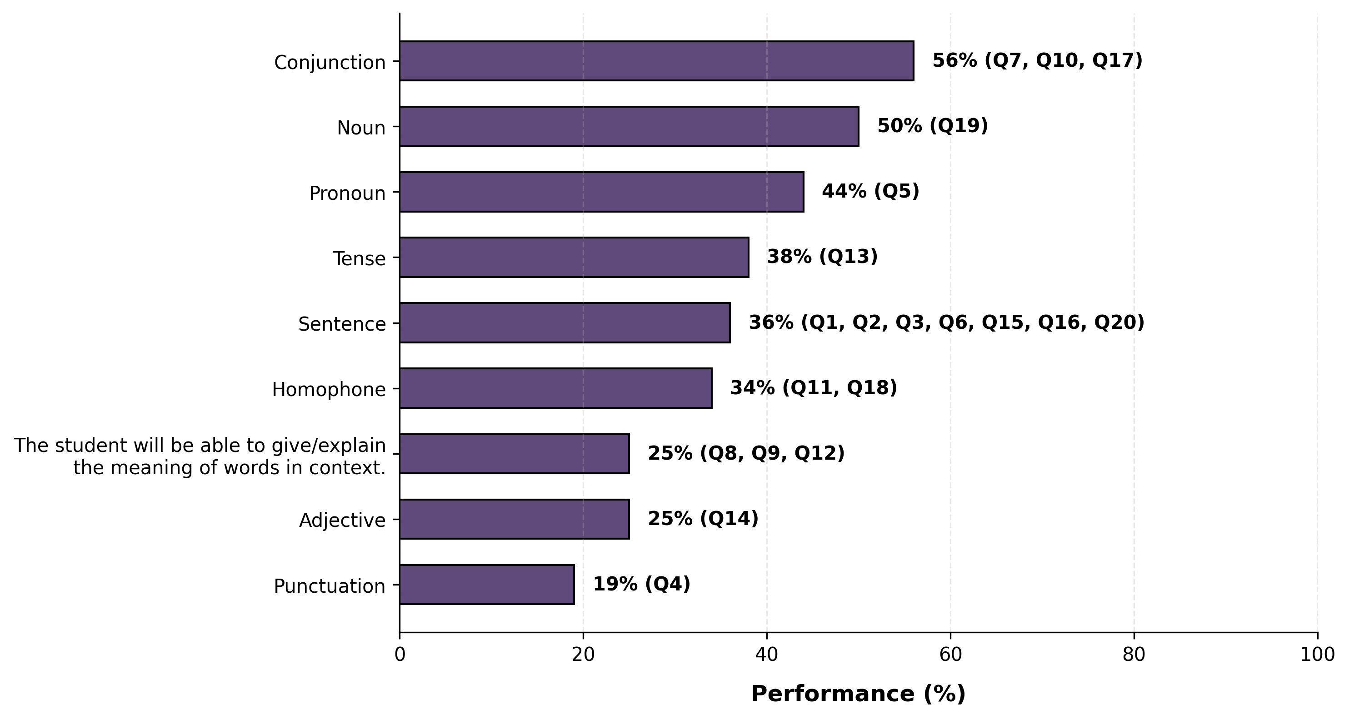
Learning Outcome Performance - Grade 8 - English

Slide 26
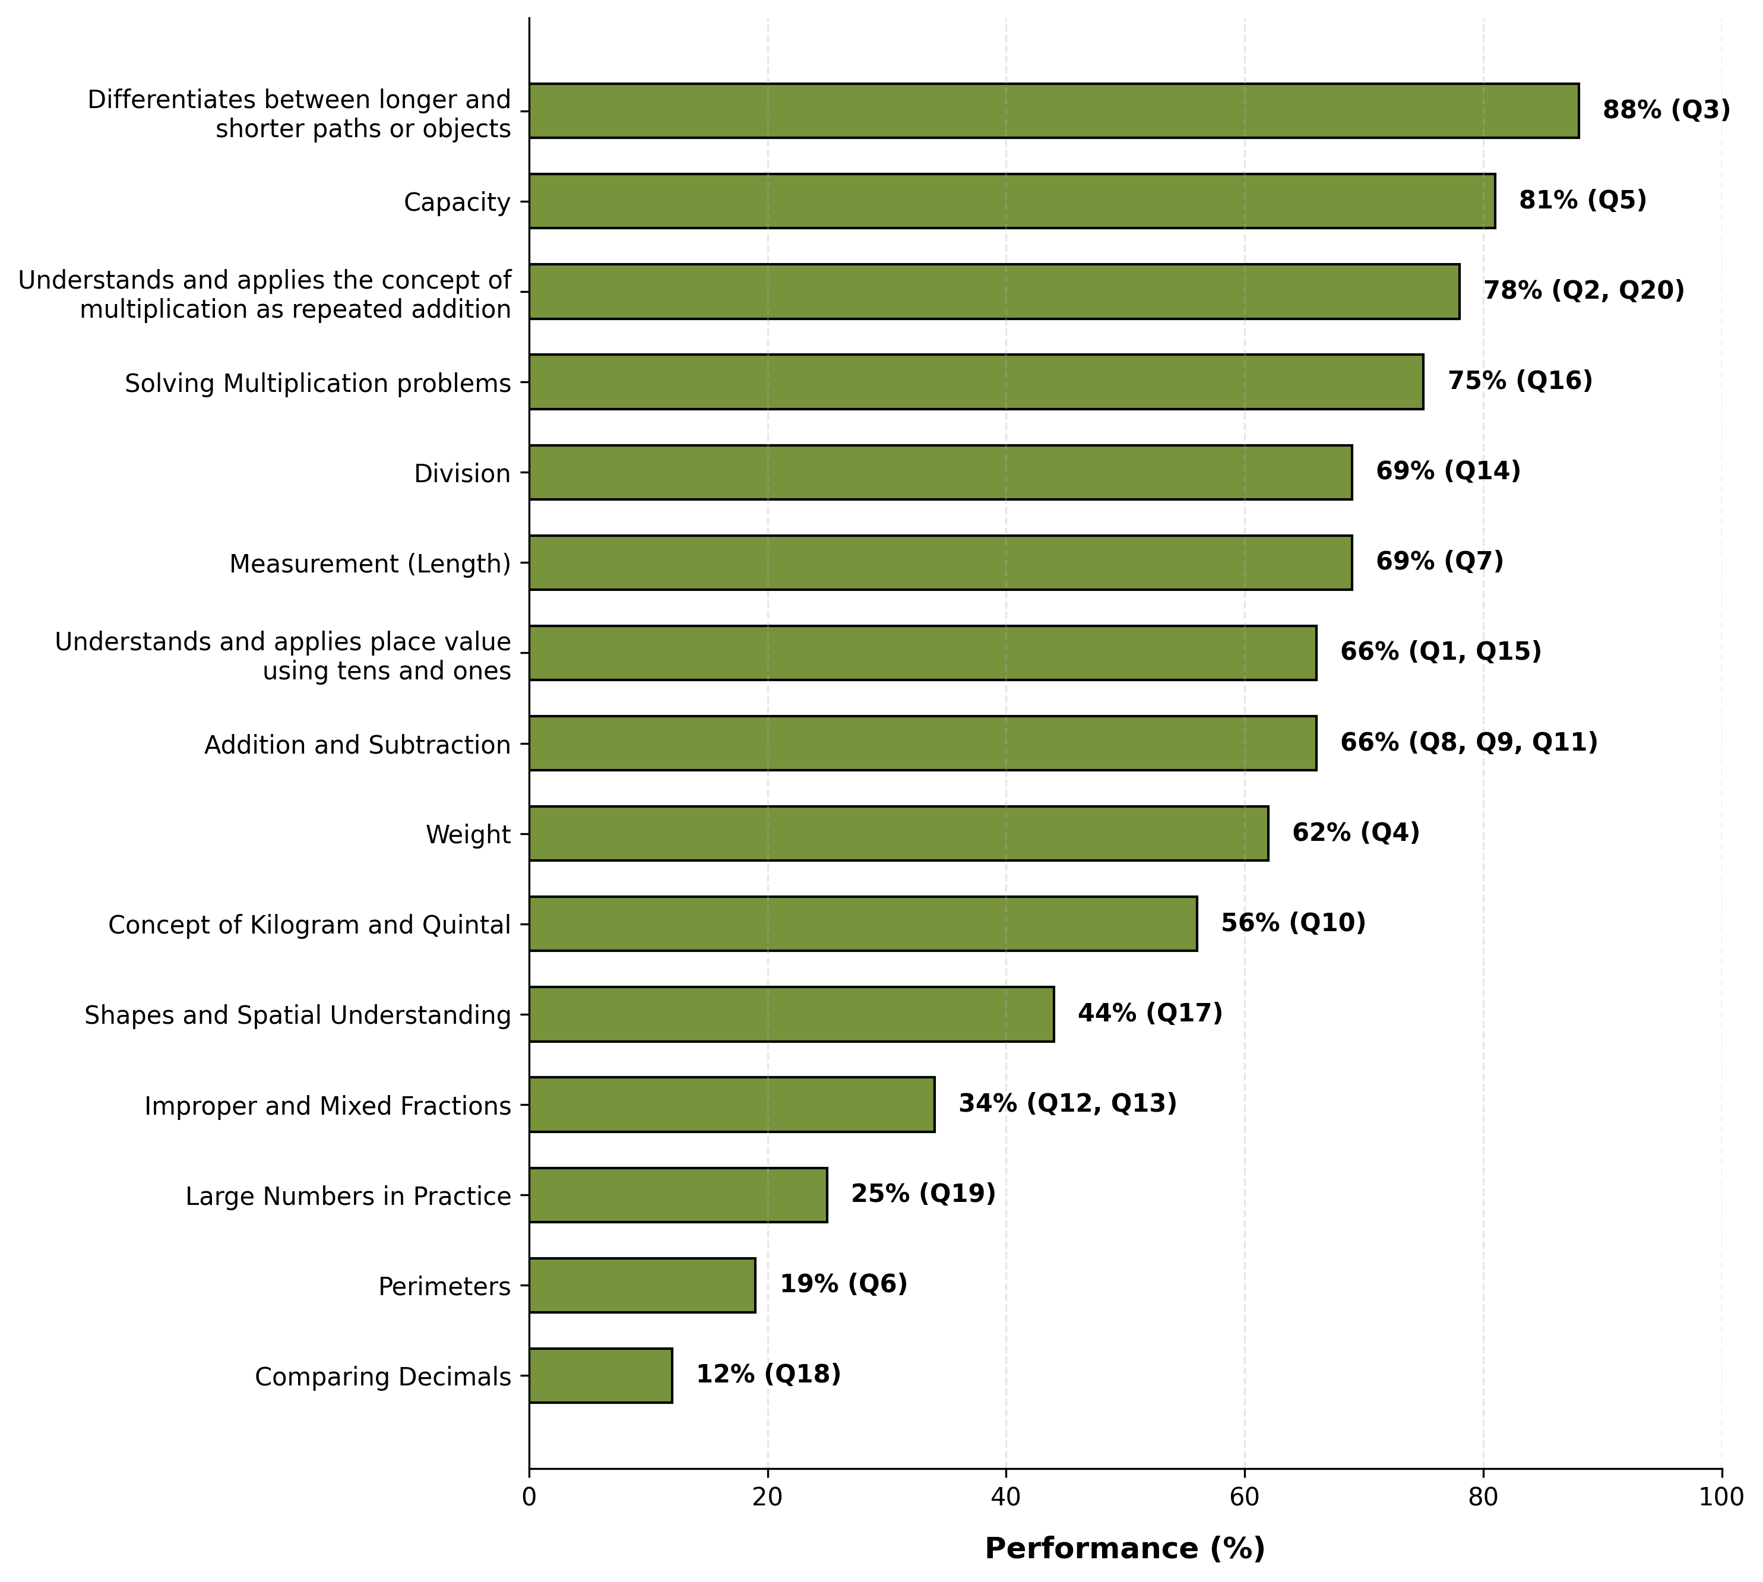
Learning Outcome Performance - Grade 8 - Mathematics

Slide 27
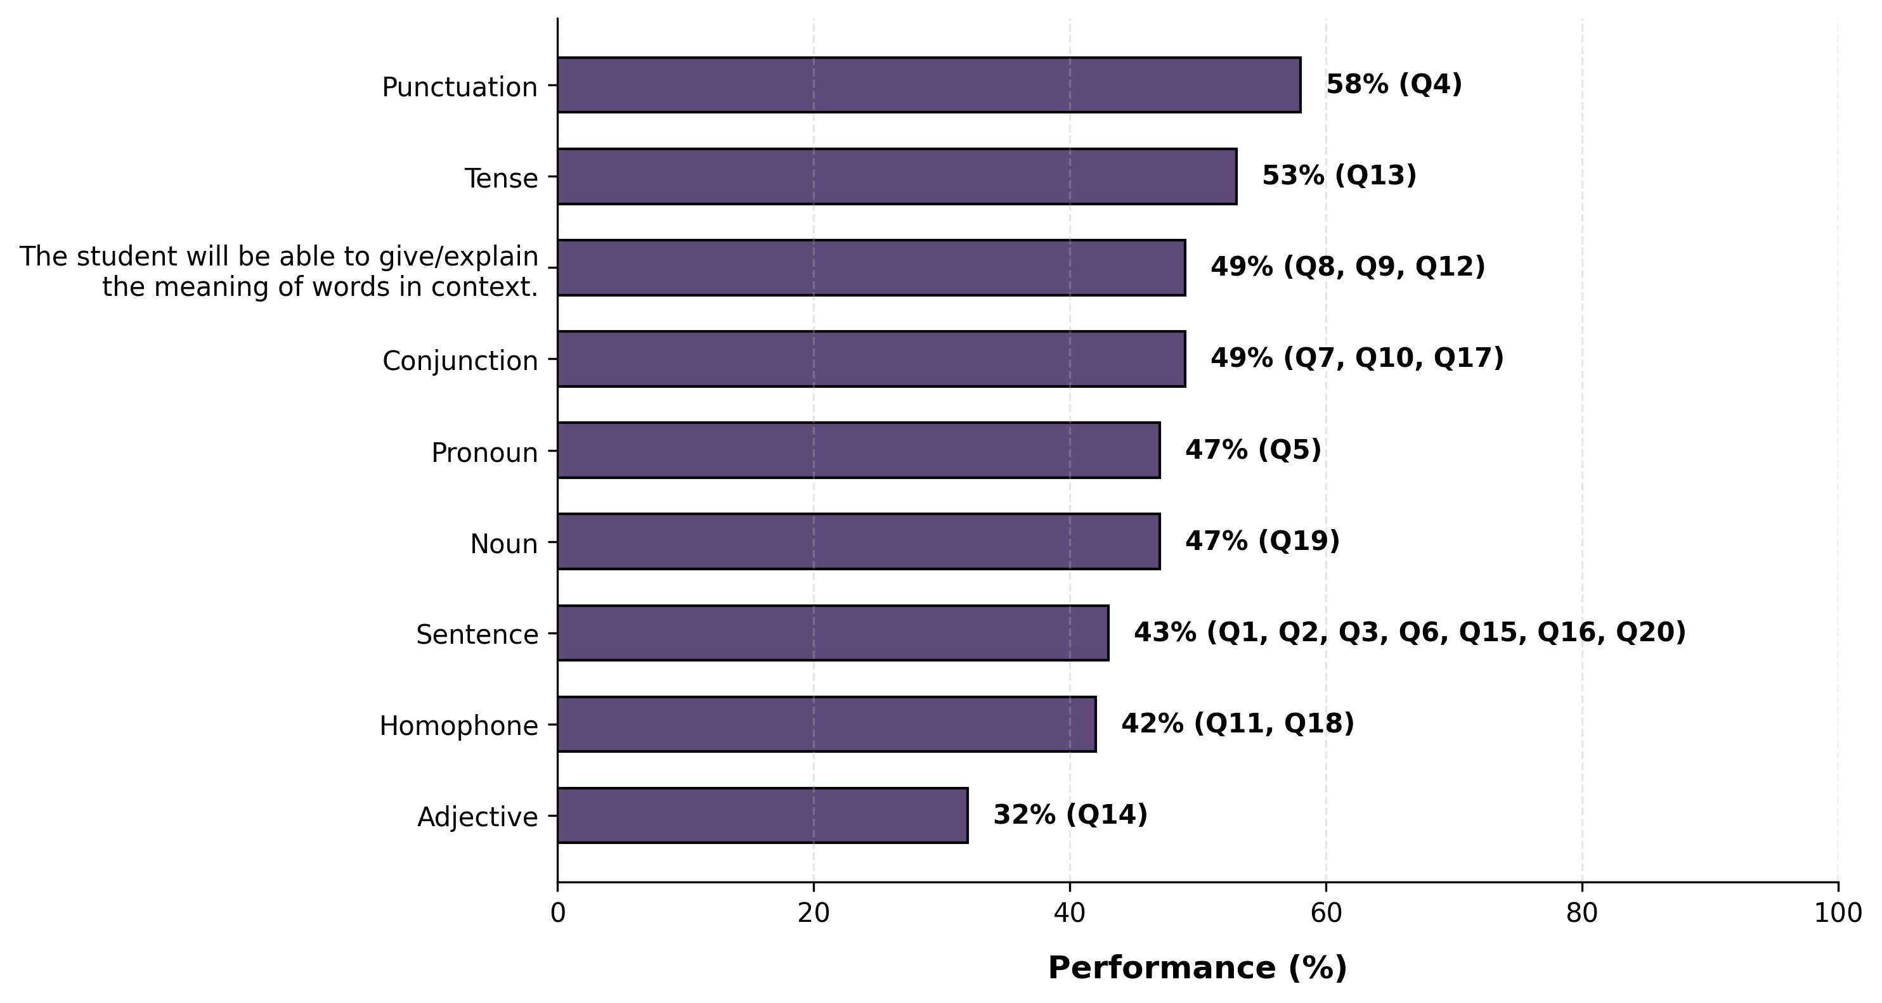
Learning Outcome Performance - Grade 9 - English

Slide 28
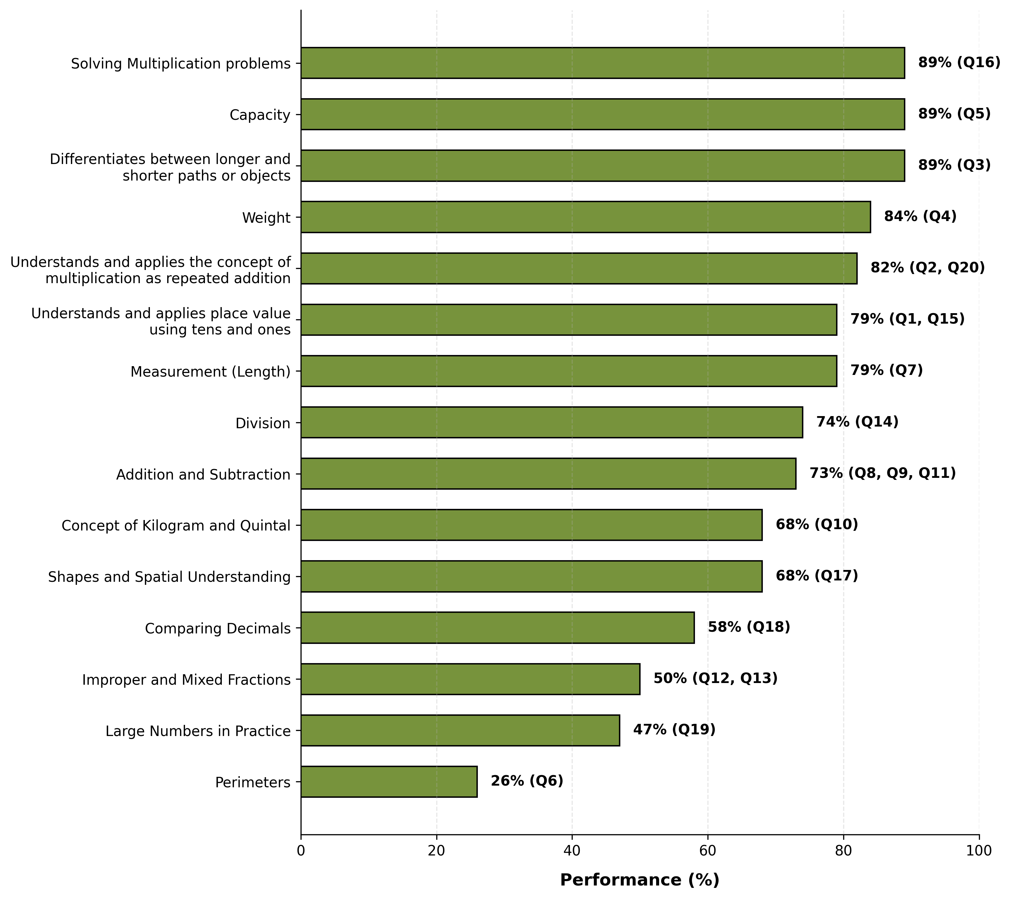
Learning Outcome Performance - Grade 9 - Mathematics

Slide 29
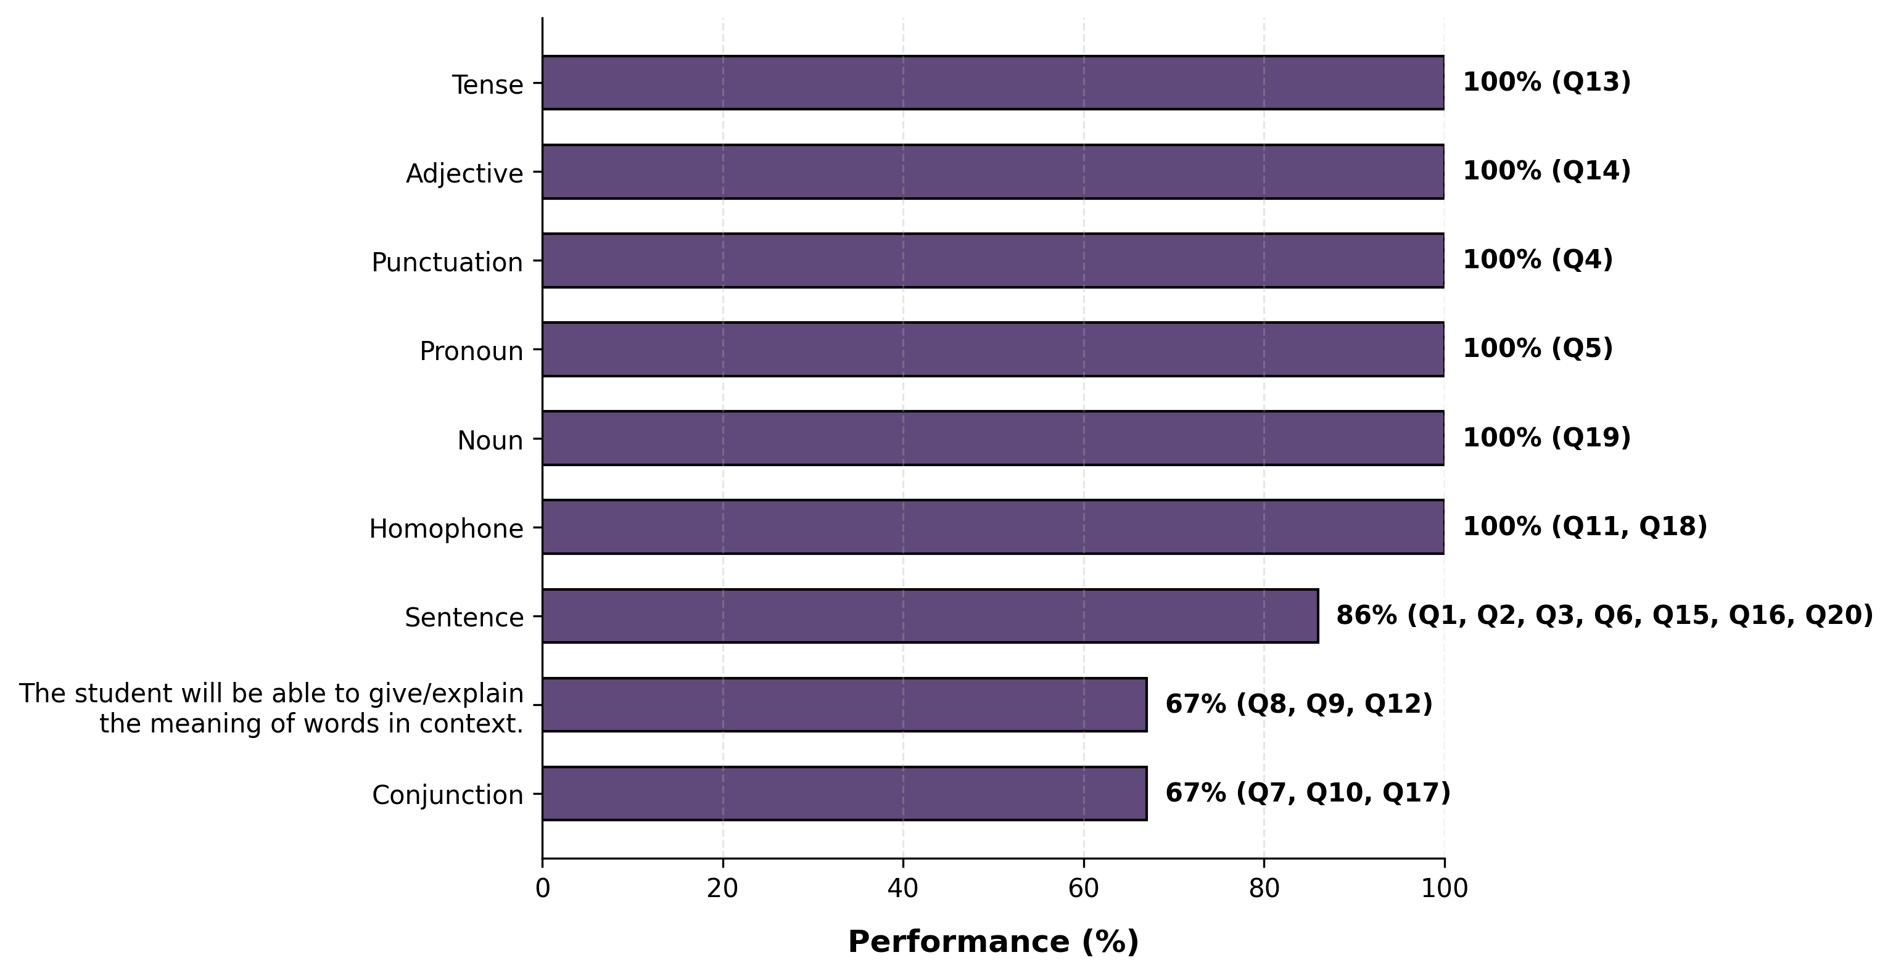
Learning Outcome Performance - Grade 10 - English

Slide 30
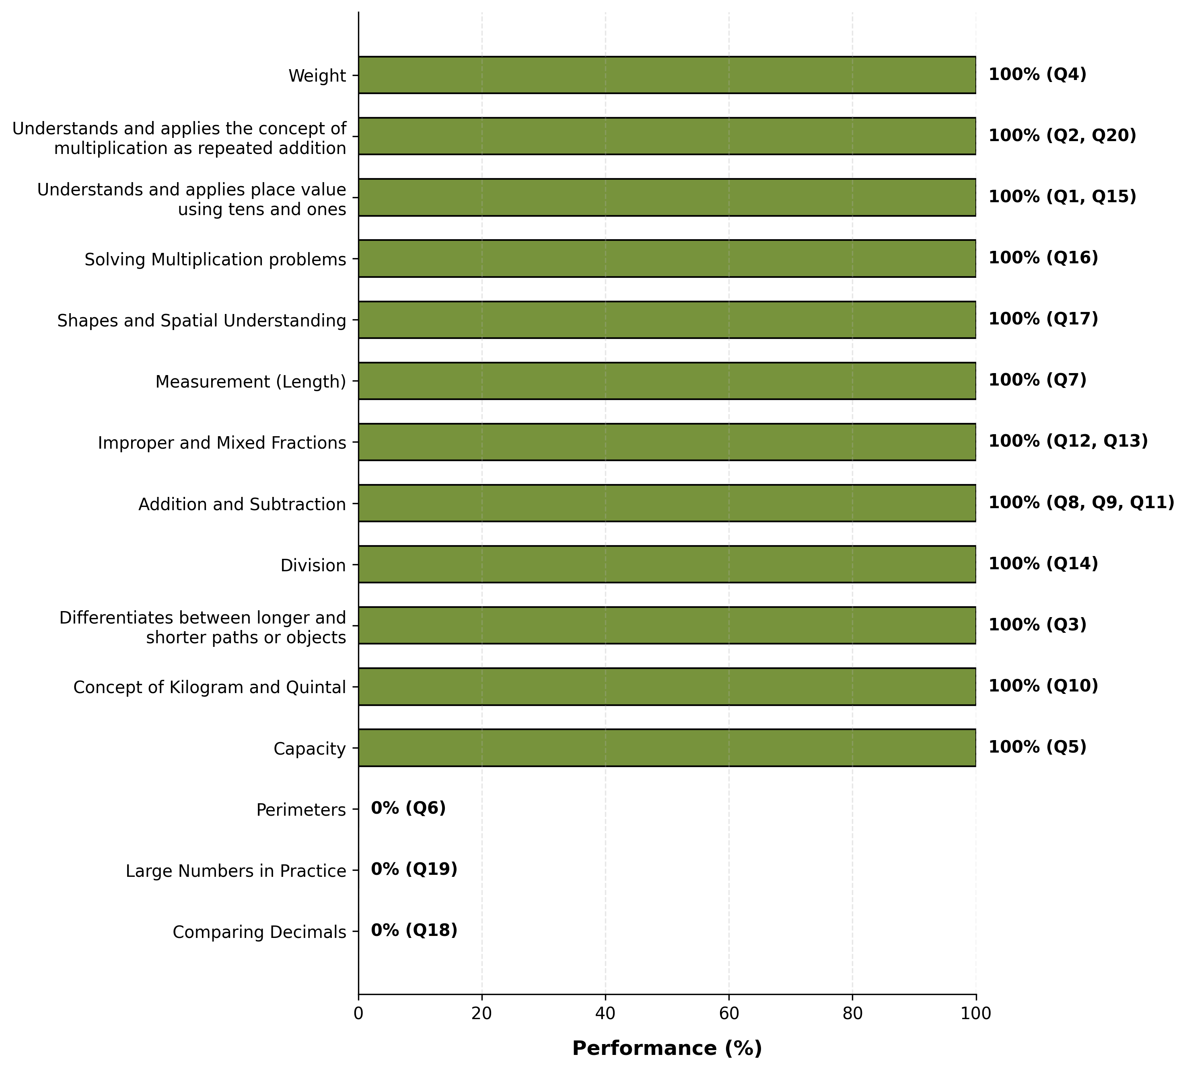
Learning Outcome Performance - Grade 10 - Mathematics

Slide 31
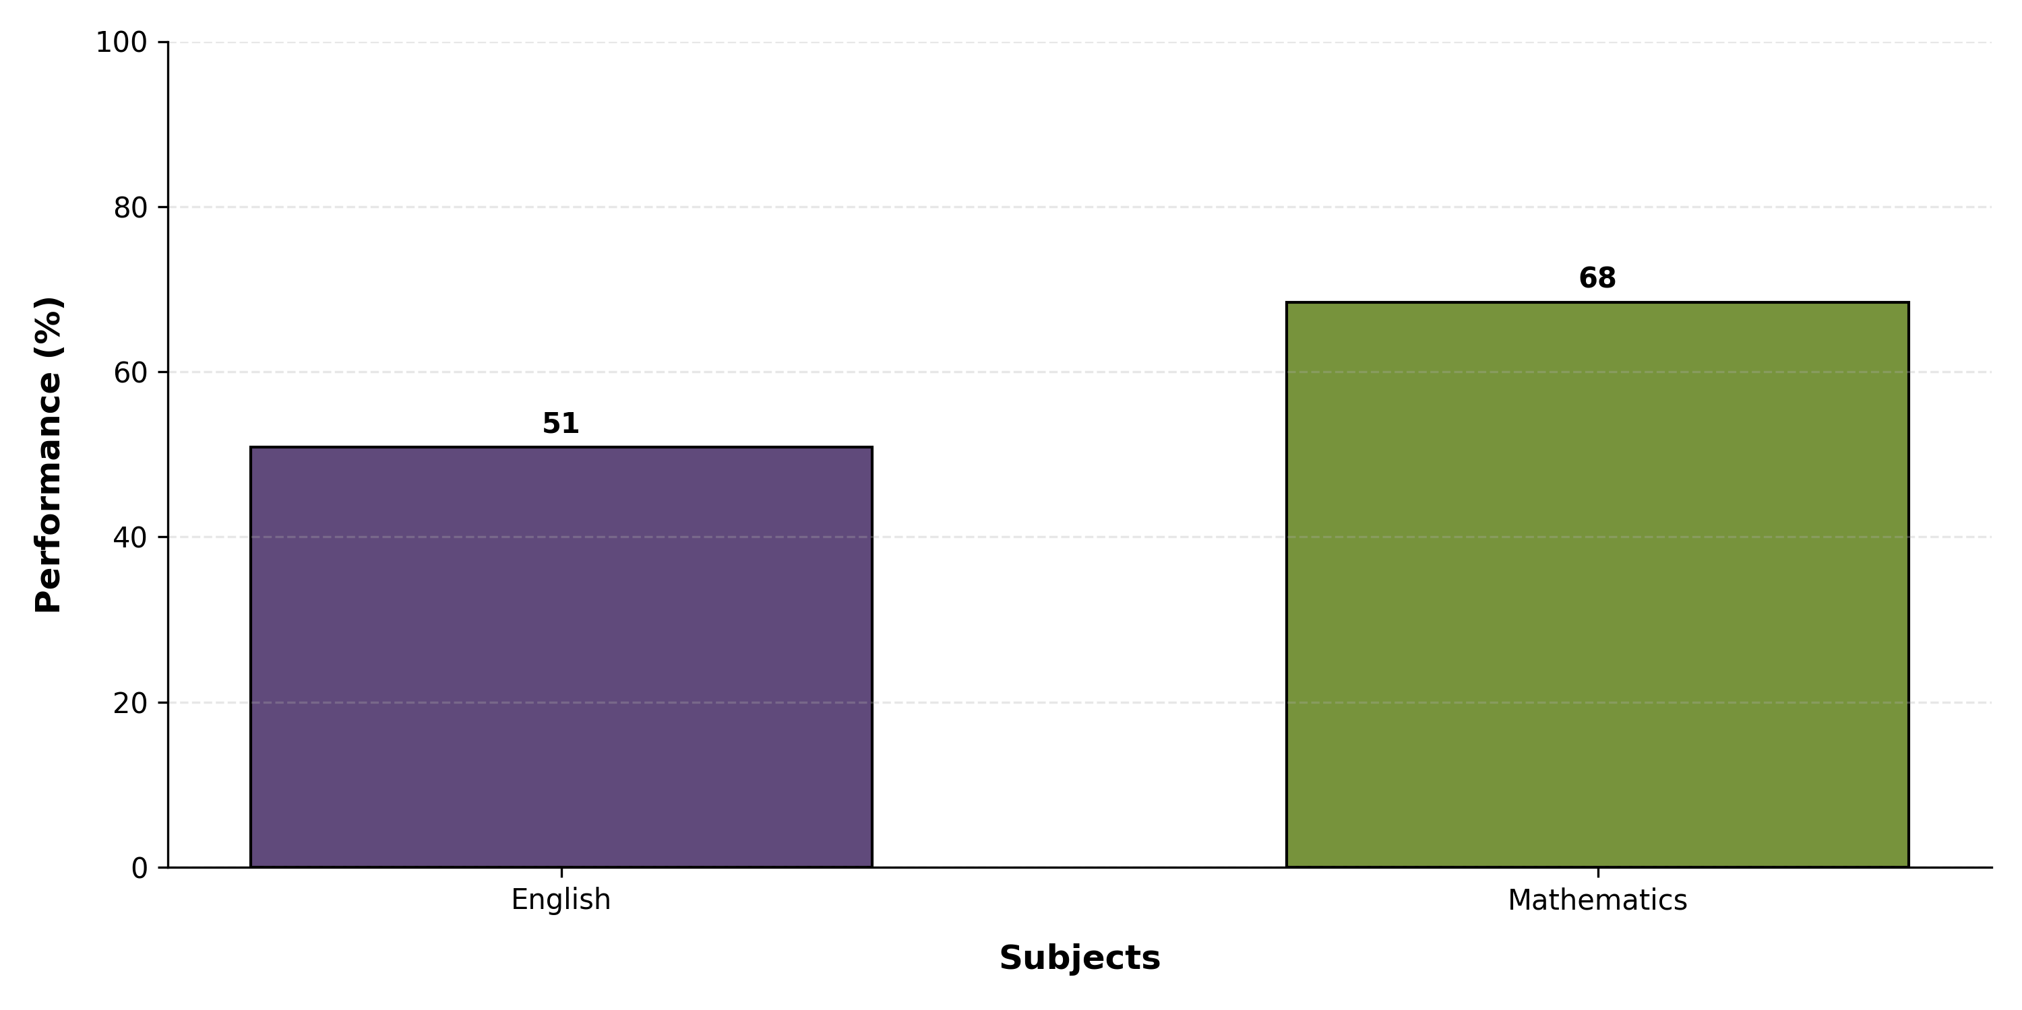
Overall Subject Performance (All Schools)

Slide 32
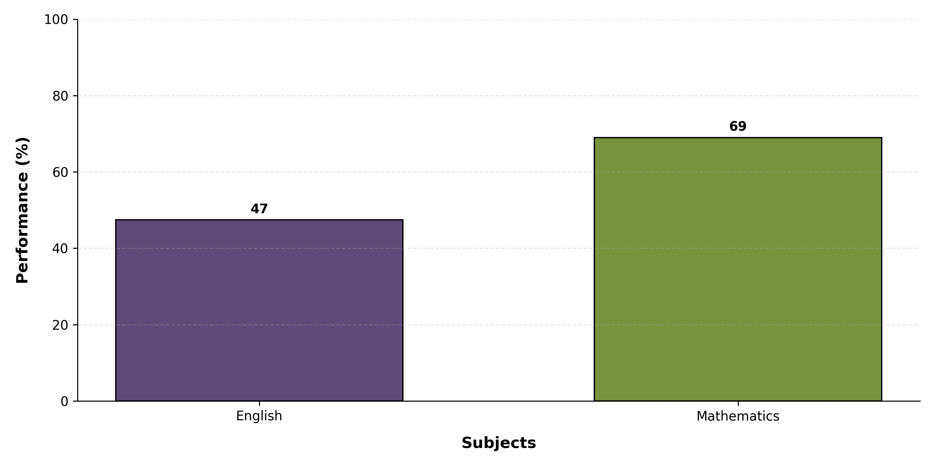
DIKSHA FOUNDATION KHEL BIHTA - Subject Performance (All Grades)

Slide 33
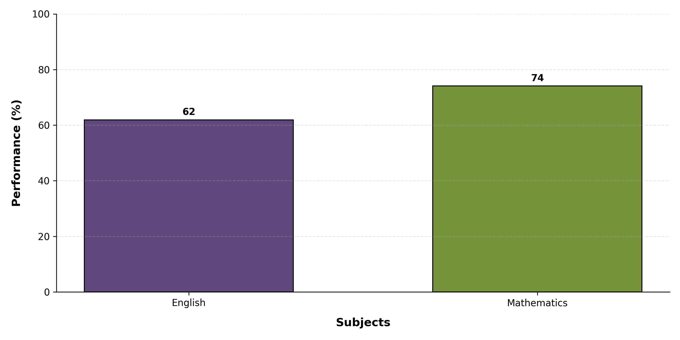
DIKSHA FOUNDATION KHEL PATNA - Subject Performance (All Grades)

Slide 34
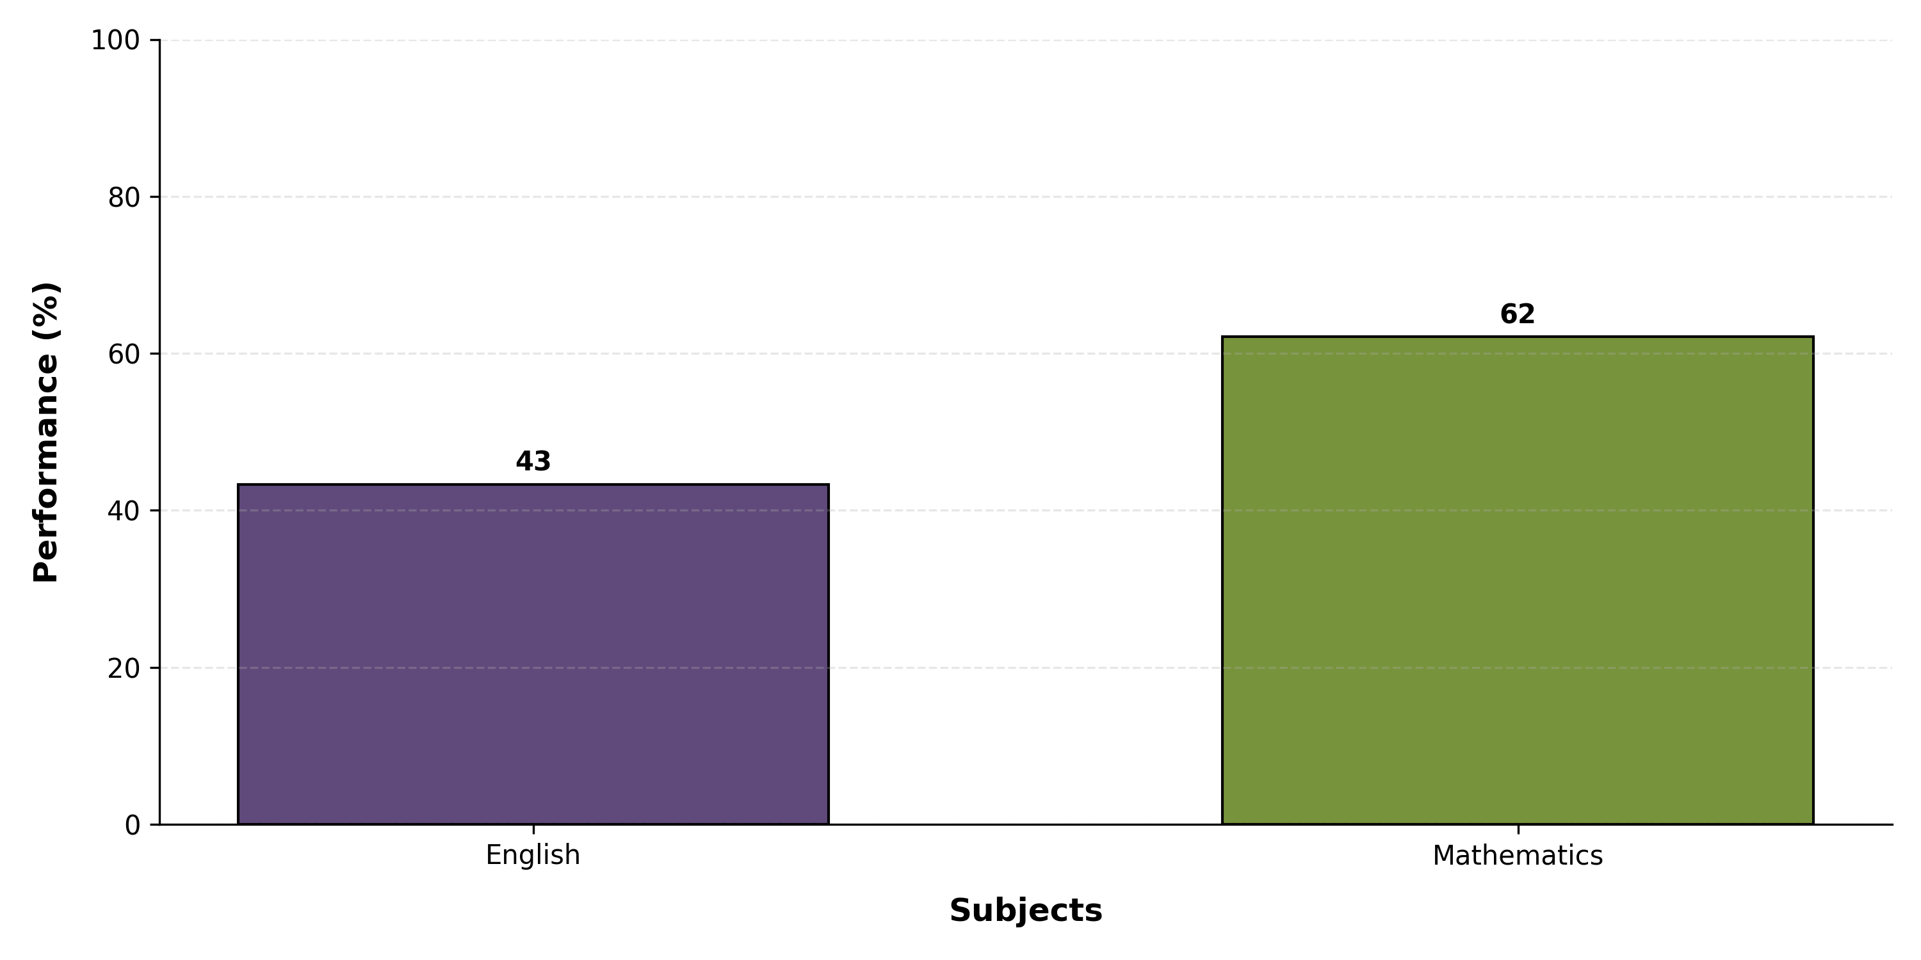
DIKSHA FOUNDATION SARAI RANJAN - Subject Performance (All Grades)

Slide 35
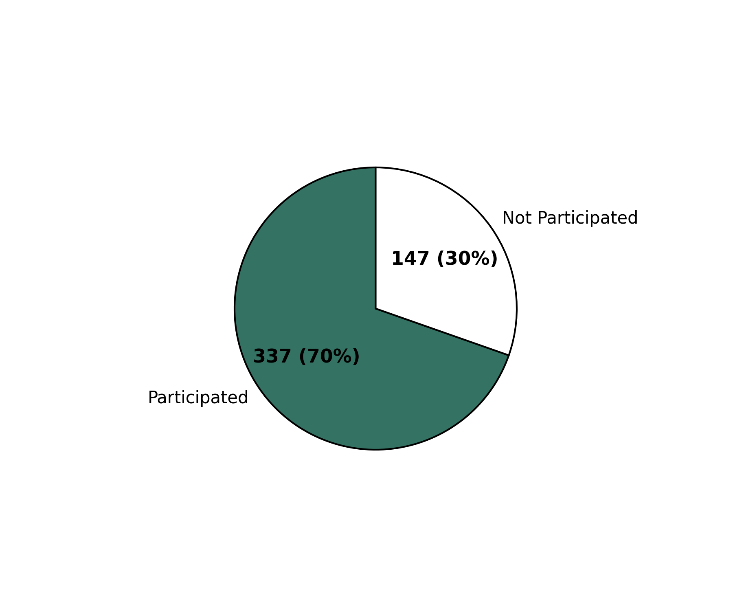
Overall Participation
Total Registrations: 484

Slide 36
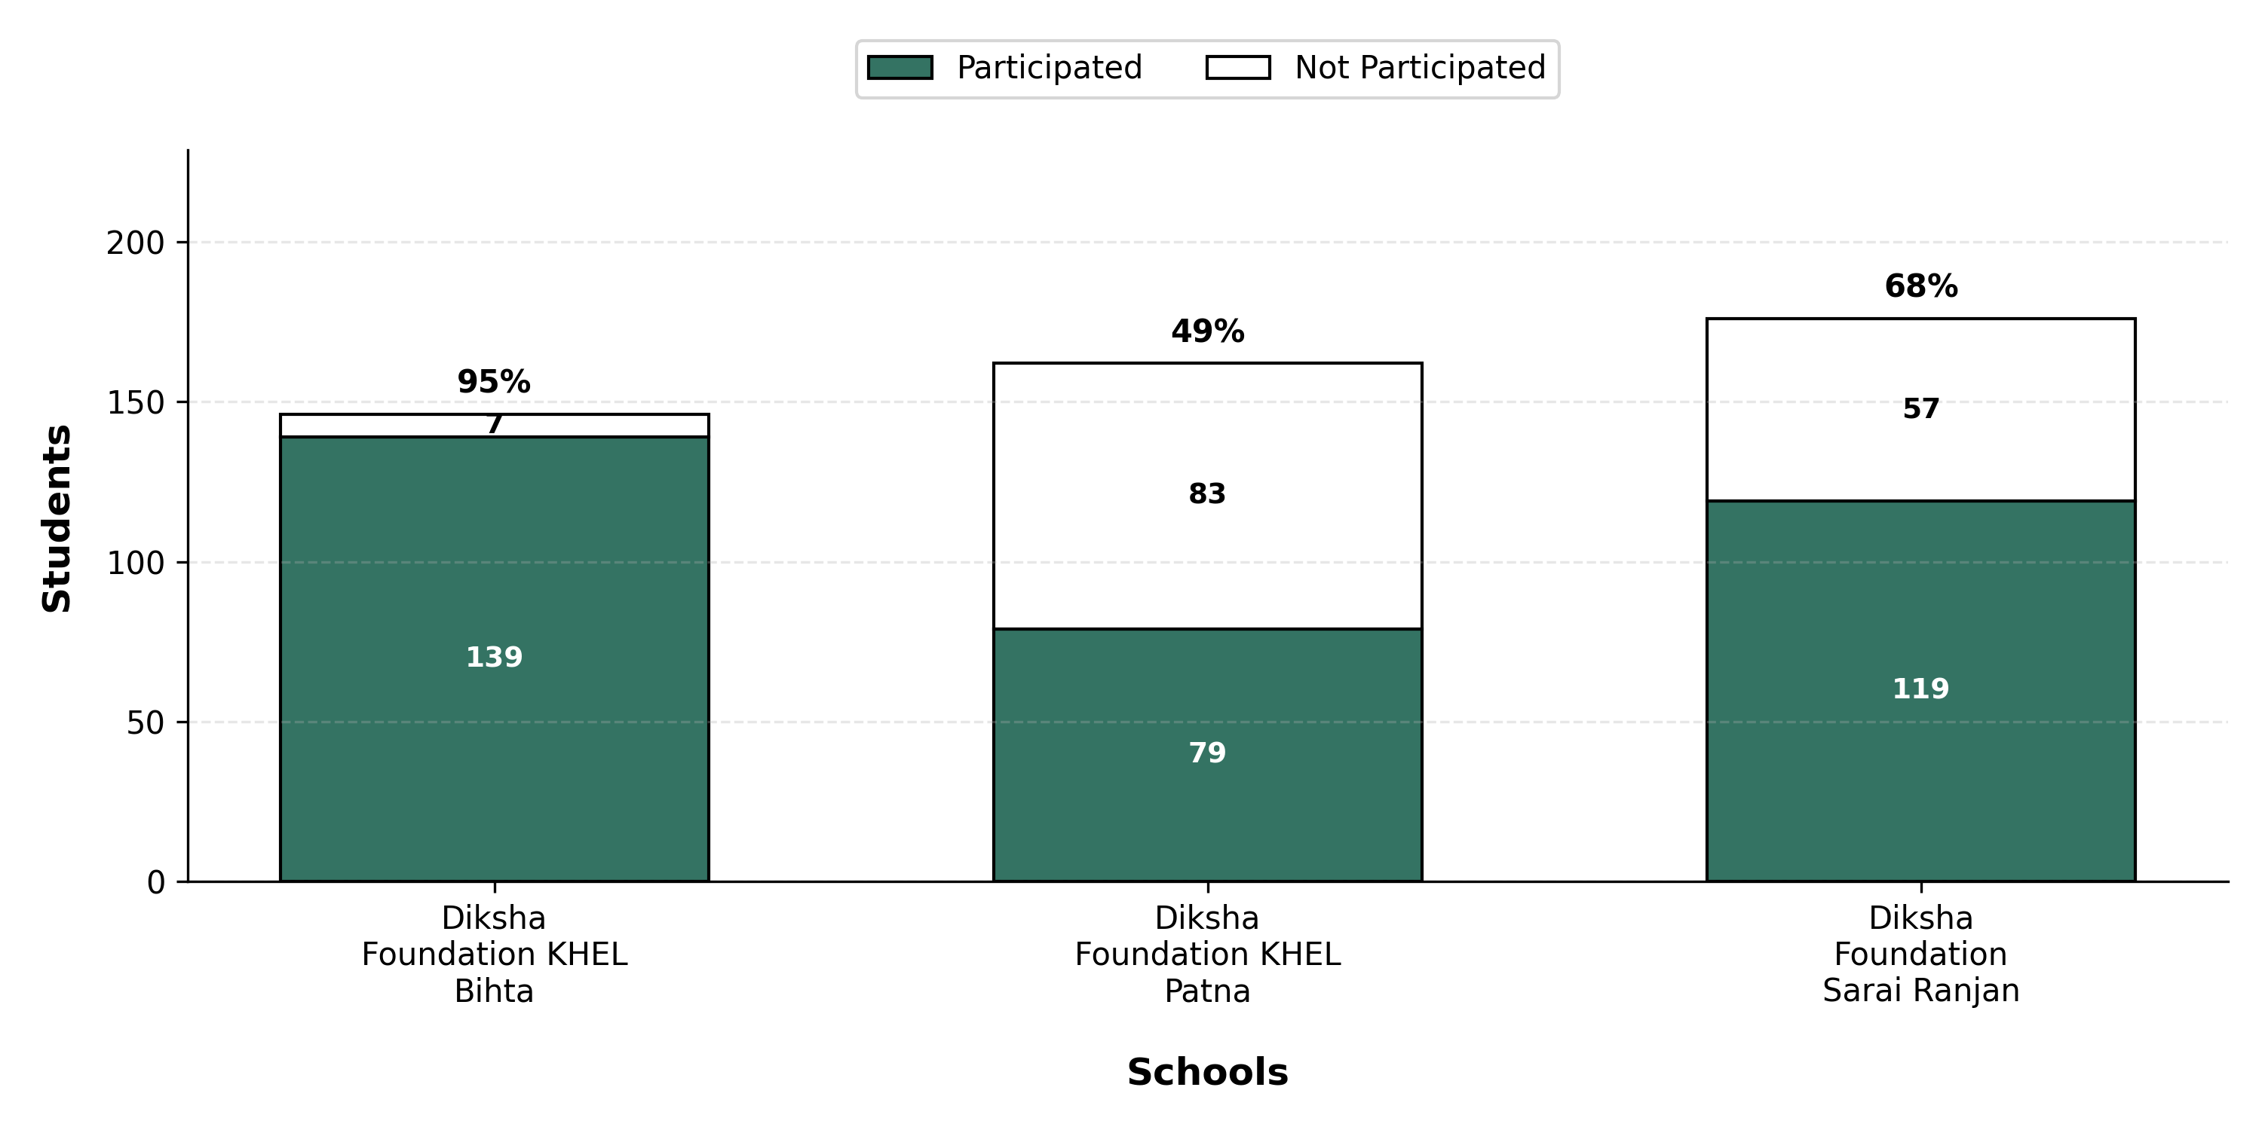
School-wise Participation

Slide 37
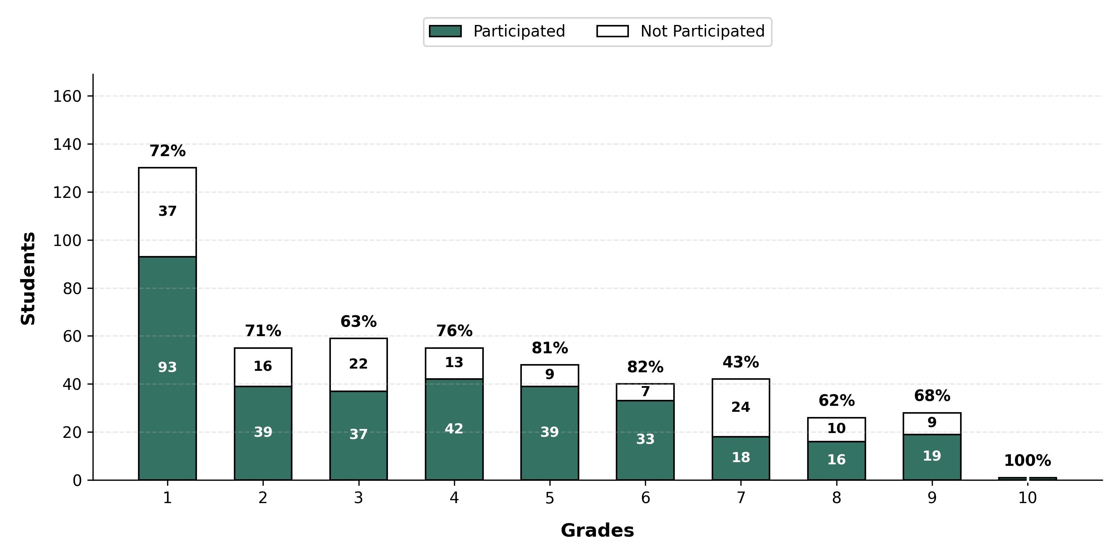
Grade-wise Overall Participation

Slide 38
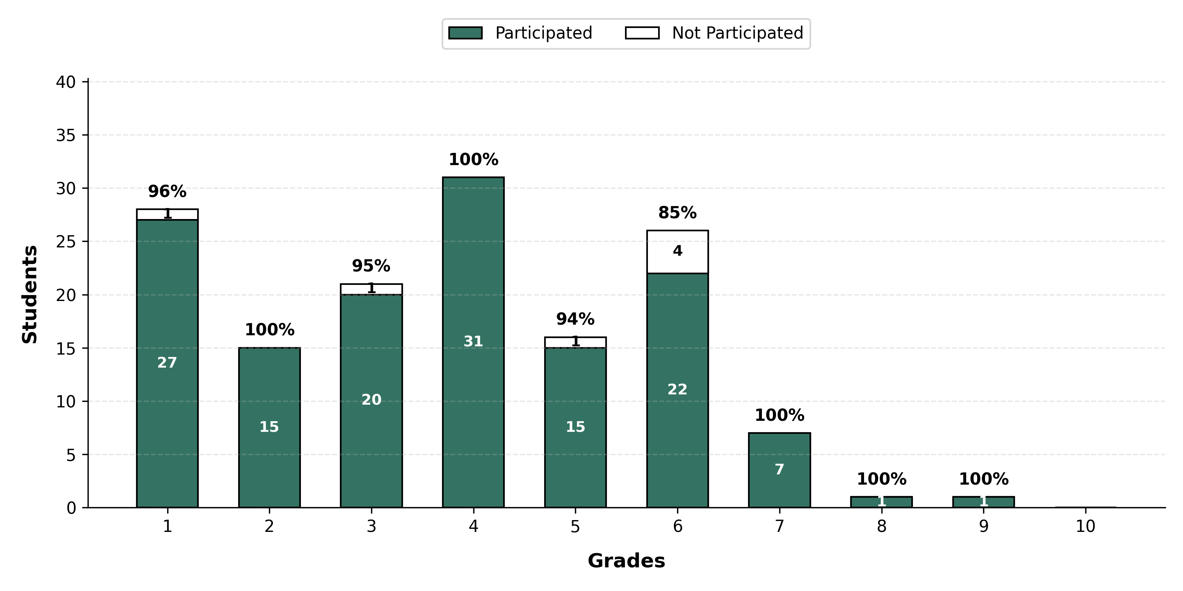
Diksha Foundation KHEL Bihta - Grade-wise Participation

Slide 39
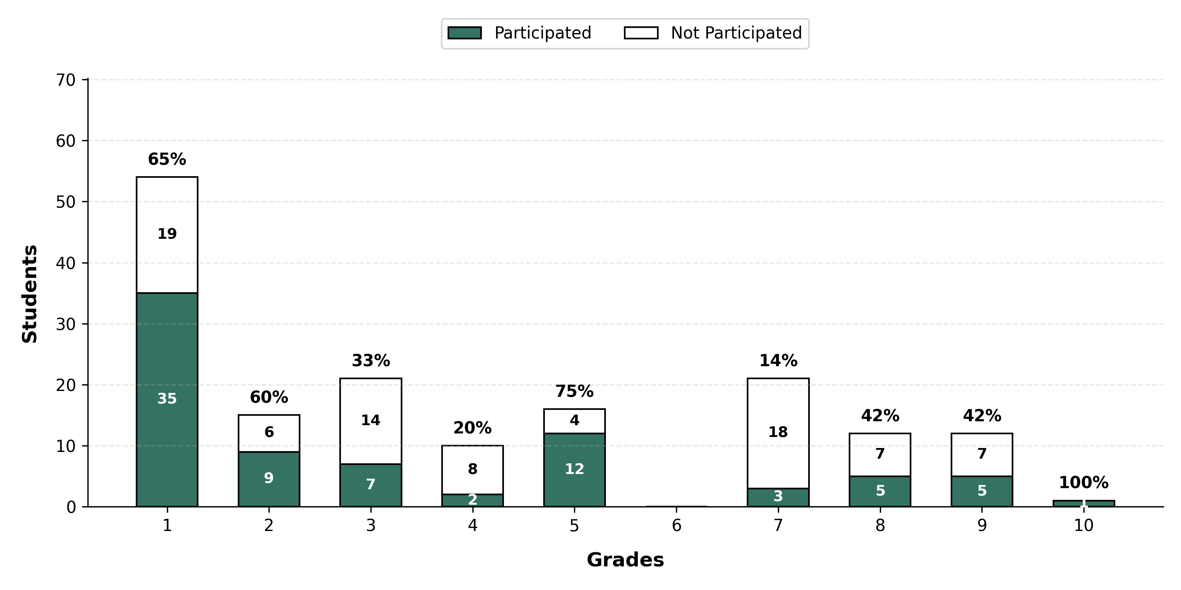
Diksha Foundation KHEL Patna - Grade-wise Participation

Slide 40
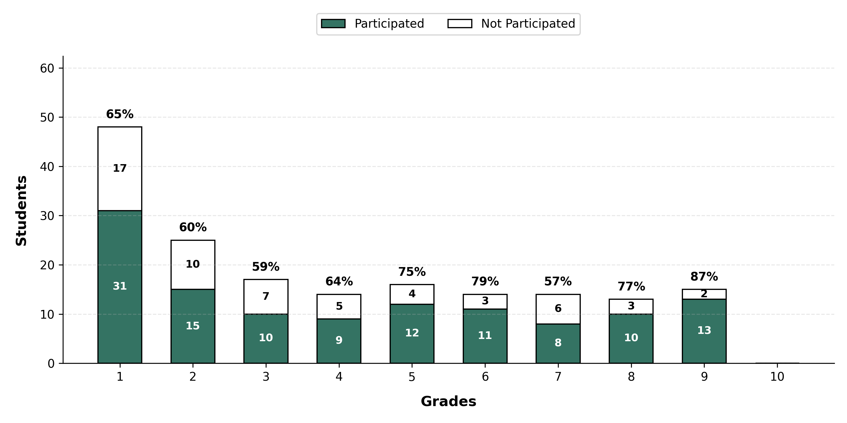
Diksha Foundation Sarai Ranjan - Grade-wise Participation

